Slide 1
Popular Content Locality Focus on the Middle East
MENOG
December 2024
Hanna Kreitem

Slide 2
Pulse tracks
Shutdowns: Where do Internet shutdowns take place?
Net Loss: Estimate the economic impacts of Internet shutdowns.
Technologies: Tracking the deployment of technologies critical for the evolution of the Internet.
Concentration: How much are services concentrated in the hands of a few?
Resilience: How robust is the Internet ecosystem?
IXP Tracker: monitors the growth of IXPs globally
Popular Content Locality

Slide 3
The 50/50 Vision
Notes:
As the cornerstone of day-to-day life, things like businesses, government, education, healthcare have all become reliant on the Internet
But every day, there are actors working to undermine it……and over 3 billion people remain unconnected.
We work to build, promote, and defend the Internet for everyone.

Slide 4
The 50/50 Vision
Our 50/50 Vision is our ambitious, yet achievable, vision to keep at least half of all Internet traffic local in selected economies.
When we reach this goal, the people who need it most will have faster, stronger, and cheaper Internet access.
Notes:
Economic benefits: Supports local ISPs, content providers, infrastructure providers
Cost benefits: Save on expensive international links, free-up bandwidth.
Quality and performance benefits: Improved Internet speeds, higher reliability, improved user experience.
Security benefits: Improve data security and privacy by keeping data in local jurisdictions.
Community building: Enhance technical community engagement through local platforms.
Importance of Consuming Local Content

Slide 5
50/50 Vision Partners
With technical communities, we seek engagement between local stakeholders to support knowledge exchange and organize events and peering forums to share best practices.
For policymakers, we seek policies that promote open markets, foster strong technical communities, and streamline regulatory processes.
The Internet Society’s organization members, individual members, chapters, special internet groups, and partners play an integral role by taking training courses and defending peering in their communities.

Slide 6
Cache Locality and Popular Content Locality
Metrics for the 50/50 Vision

Slide 7
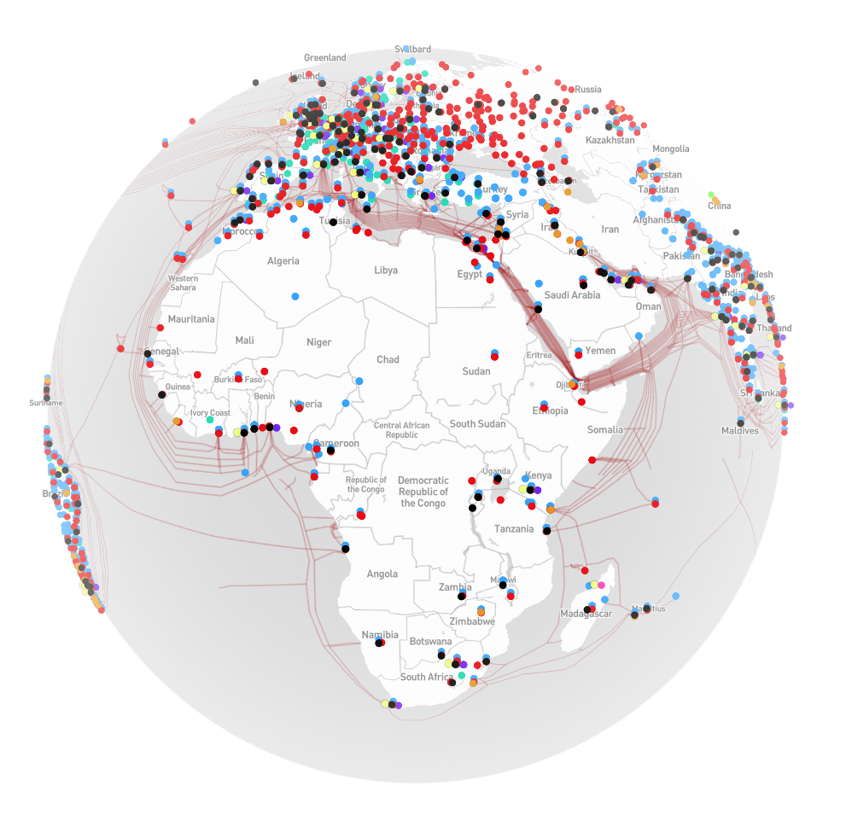
Locality definitions
Local traffic: Sourced locally from an in-country server.
External traffic: Sourced from a remote (out-of-country) server.
Content Delivery Networks: operators responsible for delivering content to the edge.
Content caches: content hosting equipment placed by a content provider close to the end-users.
Edge Network: access network where eyeballs (consumers) are located.
https://opentelecomdata.org/cdns/

Slide 8
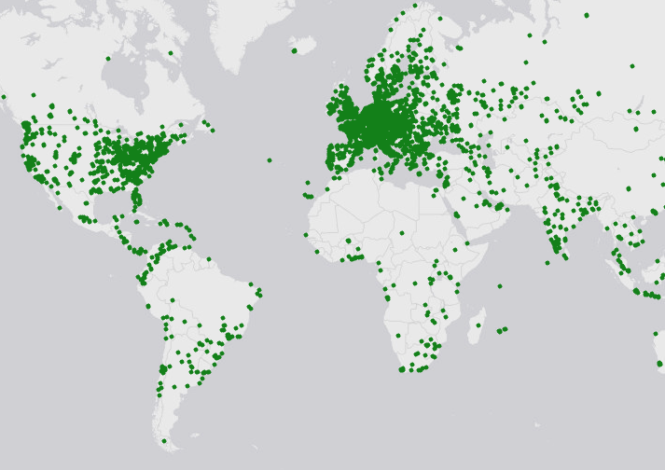
Vantage points
Residential Proxies
Can be used to run HTTP measurements
Much larger coverage than physical probes (RIPE Atlas, OONI, etc)
Real user experience (residential networks)
Source: RIPE Atlas

Slide 9
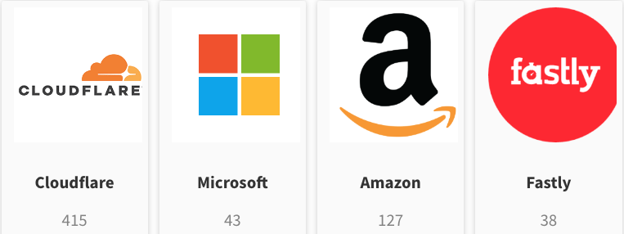
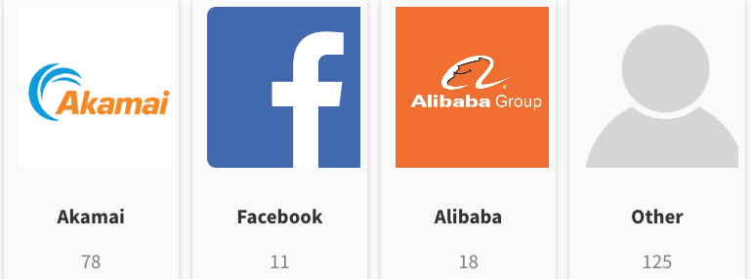
Hosting mode: CDN or Native?
Website hosting in ZA
For all 1000 websites (by country), we run a test to determine the CDN provider.
We extract CDN information from WHOIS, CNAME, HTTP Header.
We categorize by CDN provider or ”other” for natively hosted websites.
Source: Pulse

Slide 10
Aggregation
Weighted %
Local
Regional
External
∑
ASN
market
share
Local
Local
External
Local
*
=
External
Local
External
Number of websites

Slide 11
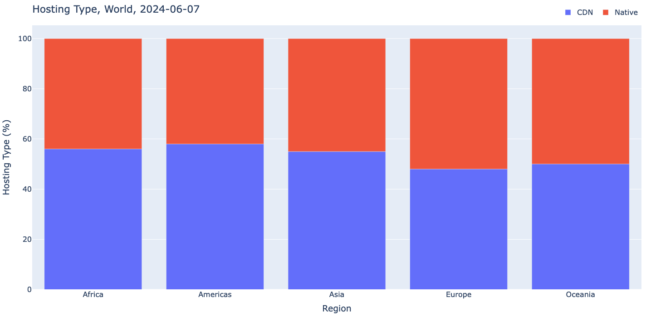
Hosting type (85k unique websites)
Source: Pulse

Slide 12
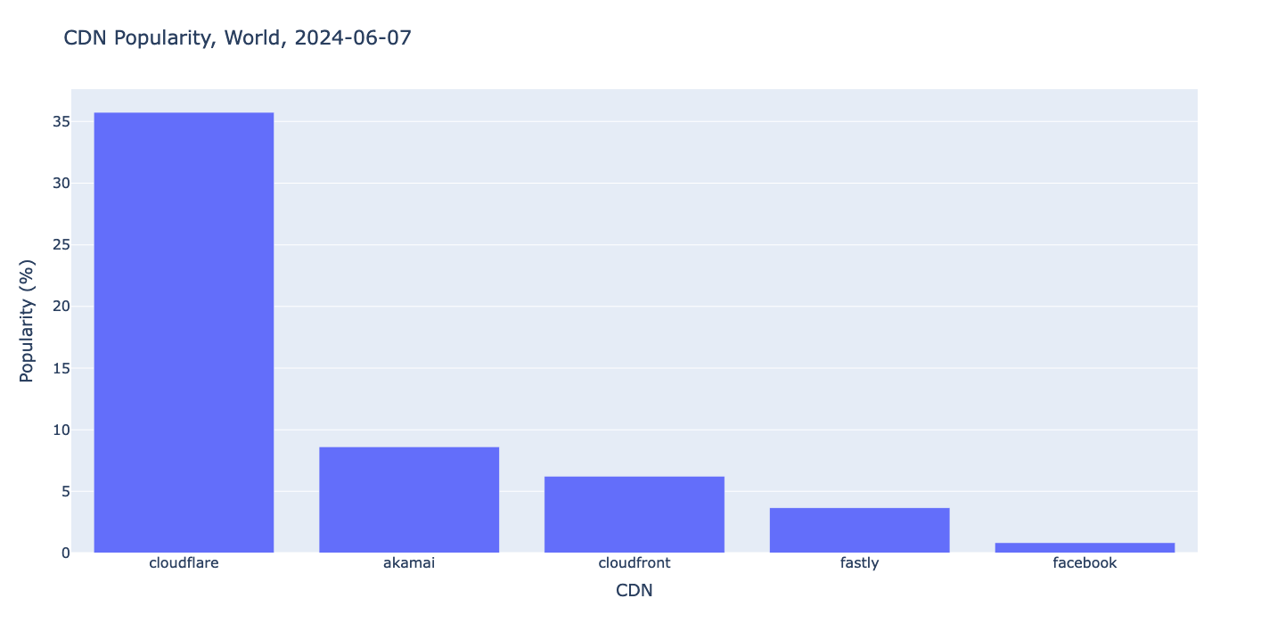
Most popular CDNs (World)
Source: Pulse

Slide 13
Cache Locality

Slide 14
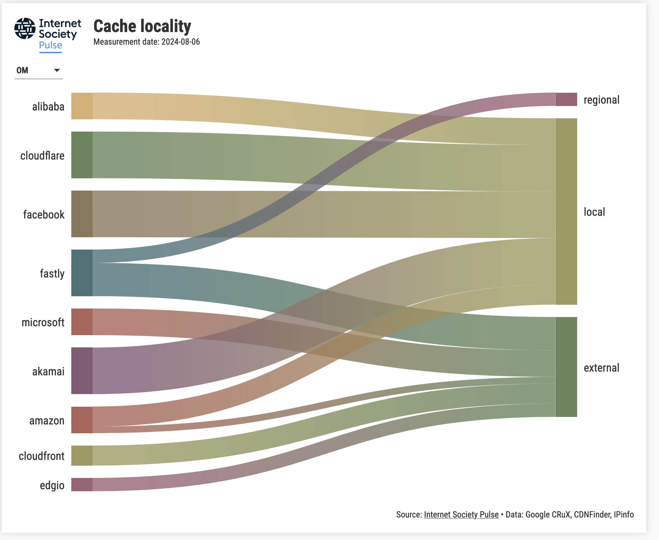
Source: Pulse

Slide 15
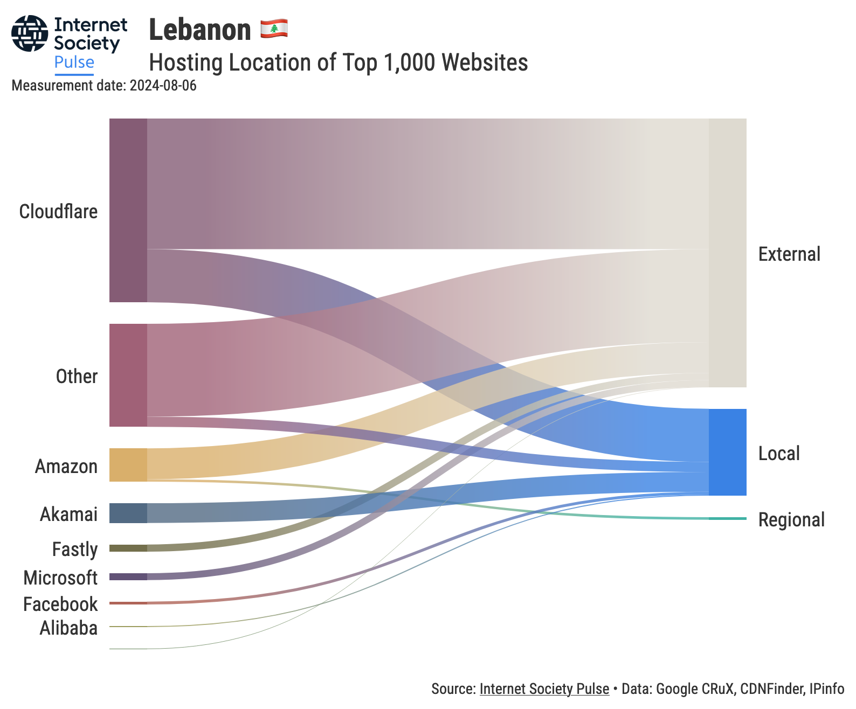
Source: Pulse

Slide 16
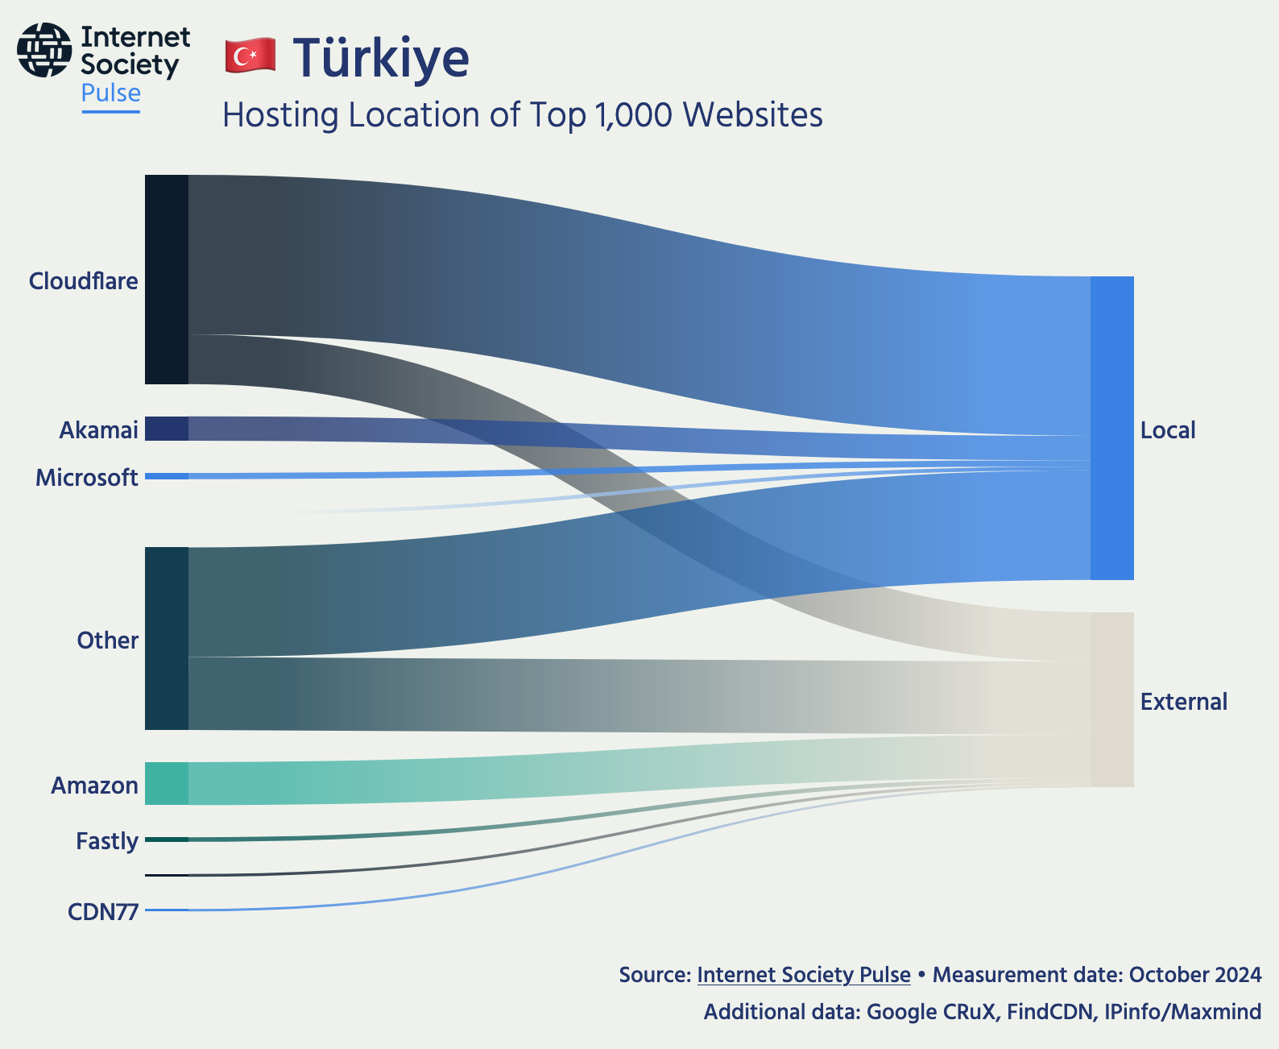
Source: Pulse
Notes:
Next is the Popular content locality

Slide 17
Popular Content Locality

Slide 18
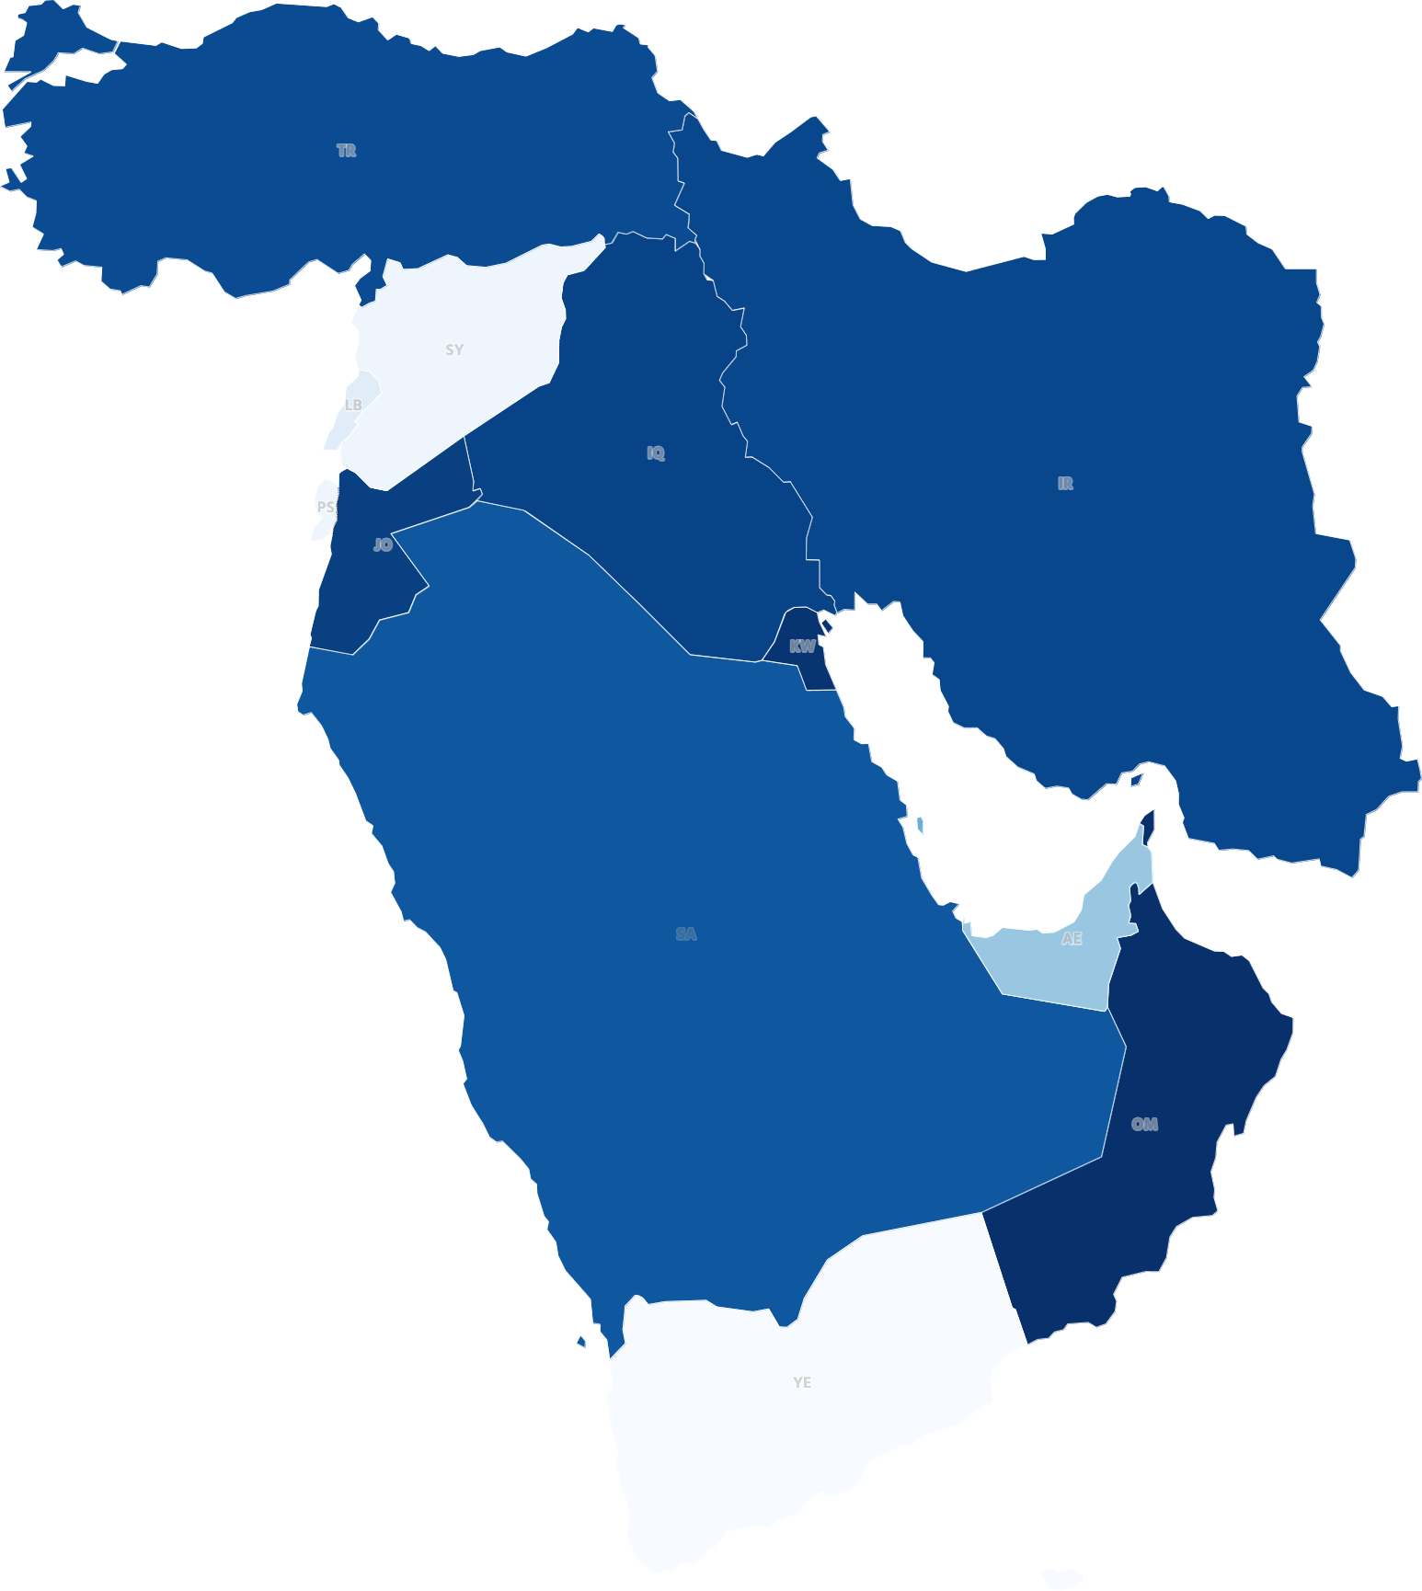
Locality (Region)
Overview of the popular content locality in the MENOG region, showing that they basically fall into three categories, <5%, ±30%, and 60-70%
Source: Pulse
Notes:
Overview of the popular content locality in the MENOG region, showing that they are basically fall into three categories, <5%, ±30%, and 60-70%

Slide 19
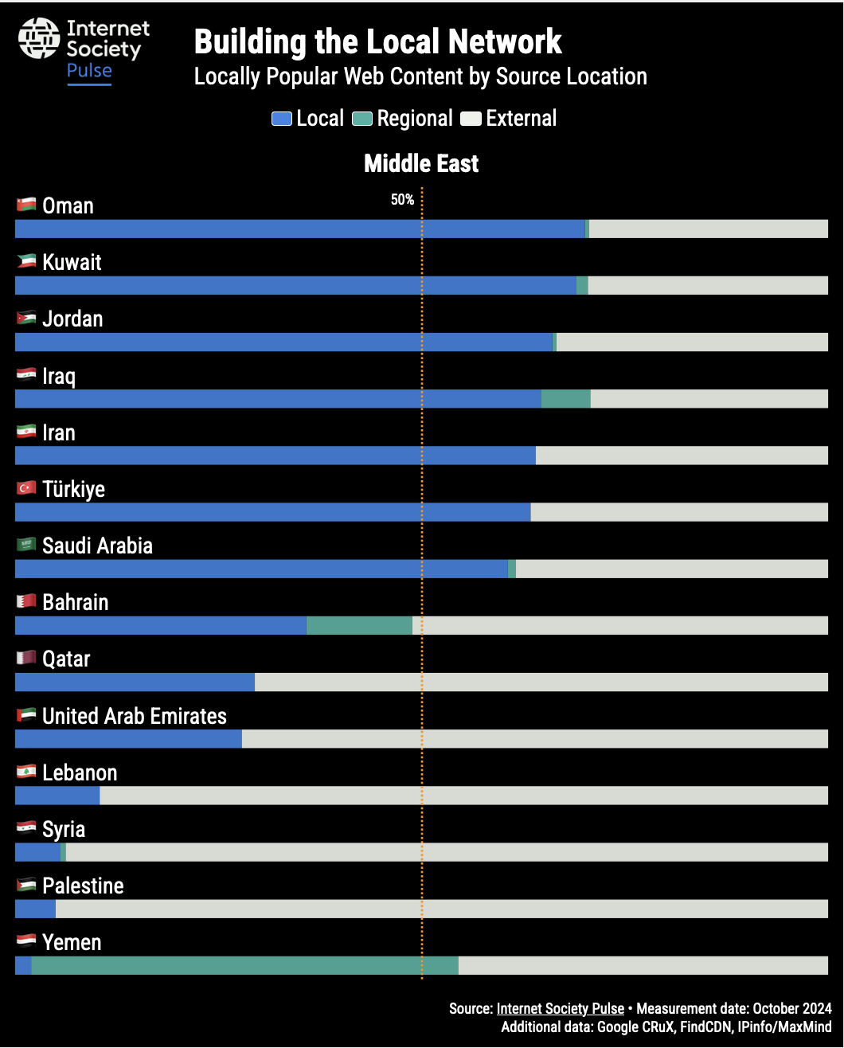
Locality (Region)
Three groups:
High, 60-70%
Medium, ~30%
Low, <10%
Source: Pulse
Notes:
Another view of the popular content locality in the MENOG region, discussing what are the reasons for the outliers and what can be done.

Slide 20
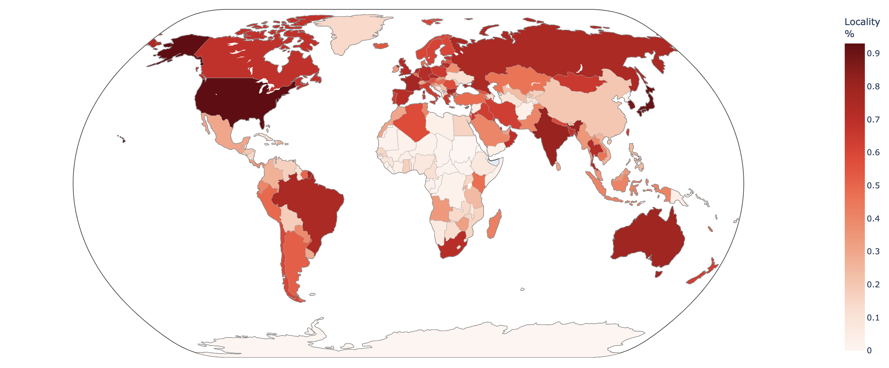
Locality (World)
July 2024, Source: Pulse

Slide 21
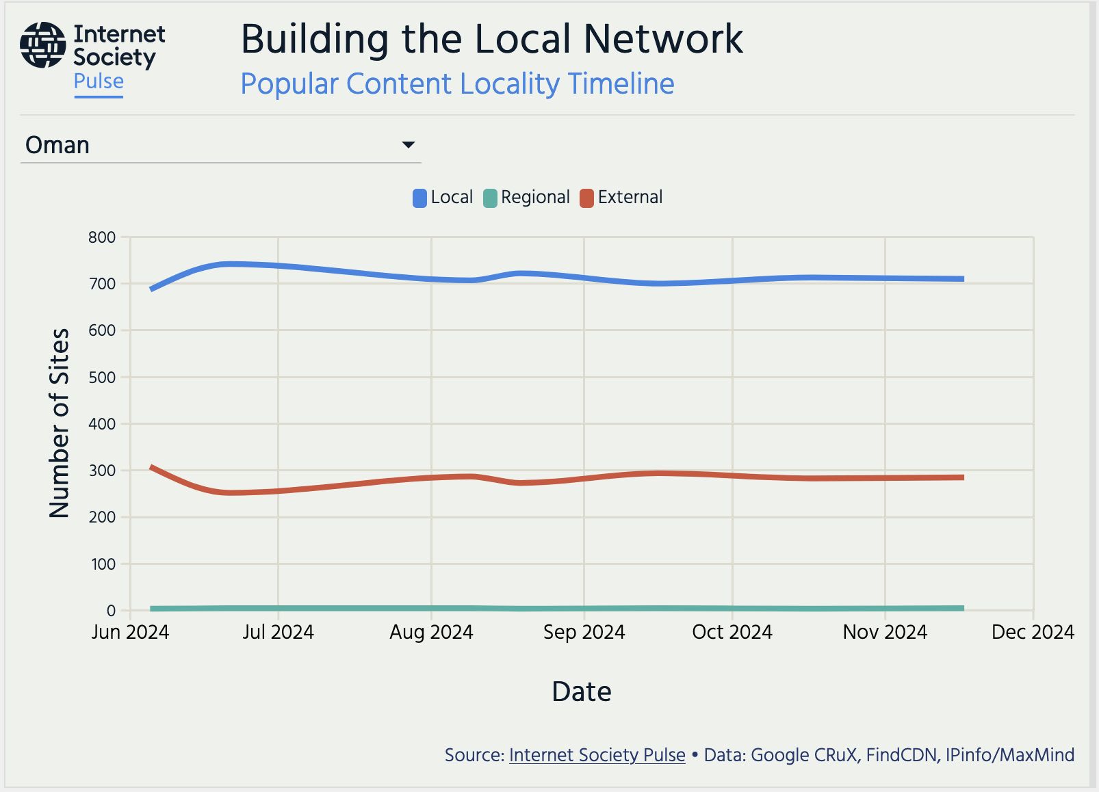
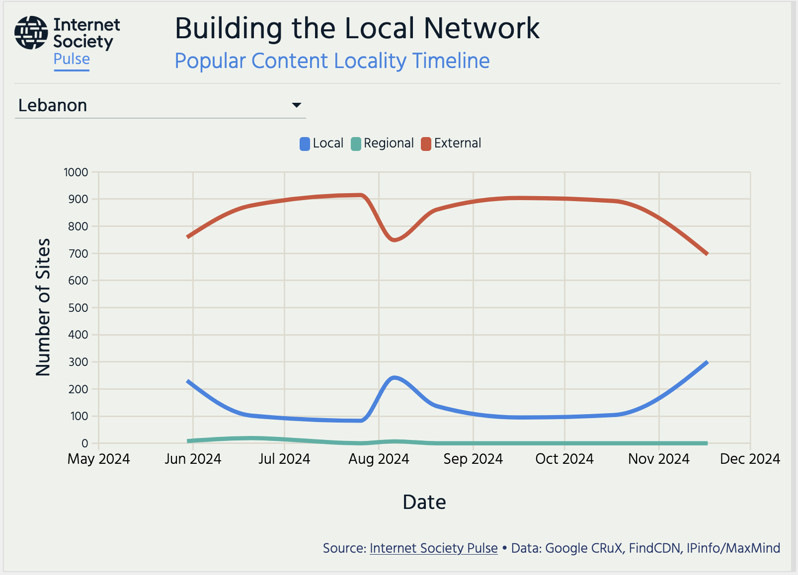
Changes in content locality
Source: Pulse
Notes:
An example of how fast results can change and why it is important to keep measuring.

Slide 22
Correlation?

Slide 23
IXP Tracker

Slide 24
IXP Tracker (now and future)
Monitors growth and development
Tracks key growth metrics of IXPs globally
Evaluates performance and reliability
Provides information on the performance and resilience of networks at the IXP.
Facilitates network optimization
Provides up-to-date information to enable data-driven peering decisions.
Foster community engagement
Provides a platform for IXP members to connect, share knowledge, and collaborate.
Notes:
This flexibility ensures that the insights are tailored and meaningful, facilitating more informed decisions and strategic planning.

Slide 25
Components
Collects data on more than 1000 IXPs globally from PeeringDB/PCH.
Provides information about capacity and membership growth.
Shows a country and an IXP view.
PCH
PeeringDB
Members, capacity, reachability
IXP Tracker
API (soon)
RIPE
Atlas
IXP
Looking glasses
Live measurements (coming soon)

Slide 26
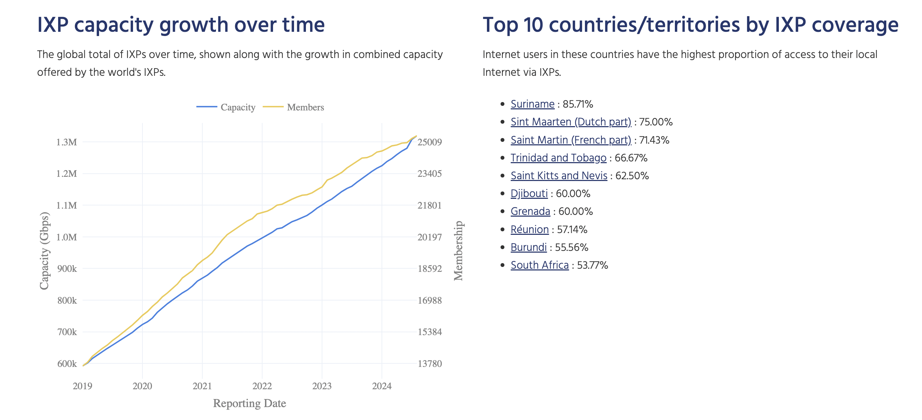
Global view

Slide 27
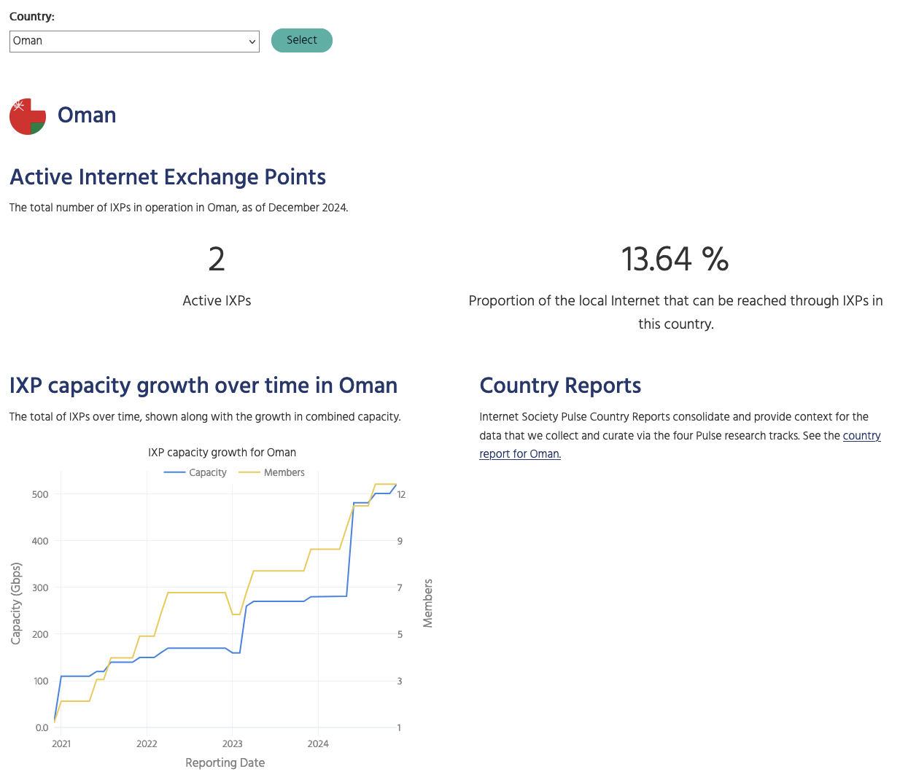
Country view

Slide 28
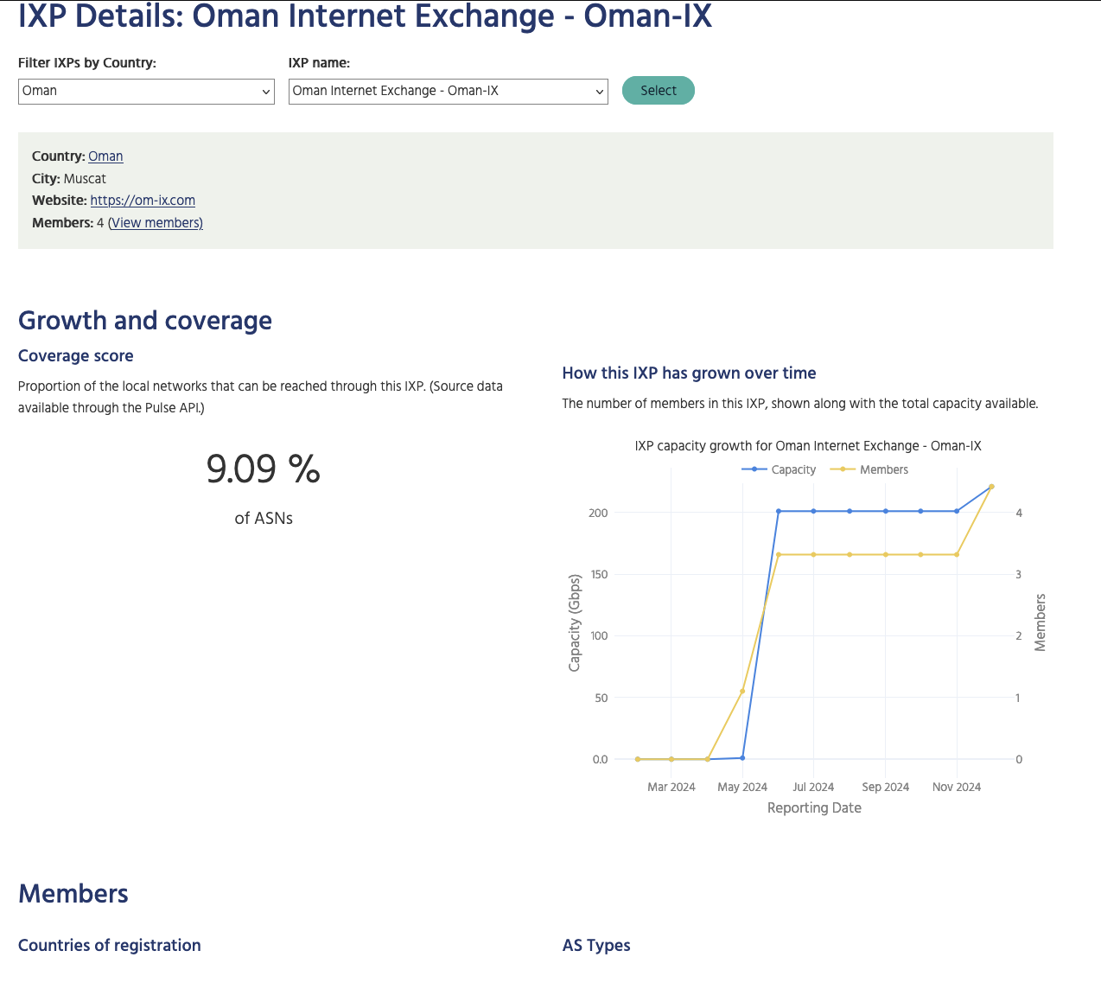
IXP view

Slide 29
IXP Tracker 2.0

Slide 30
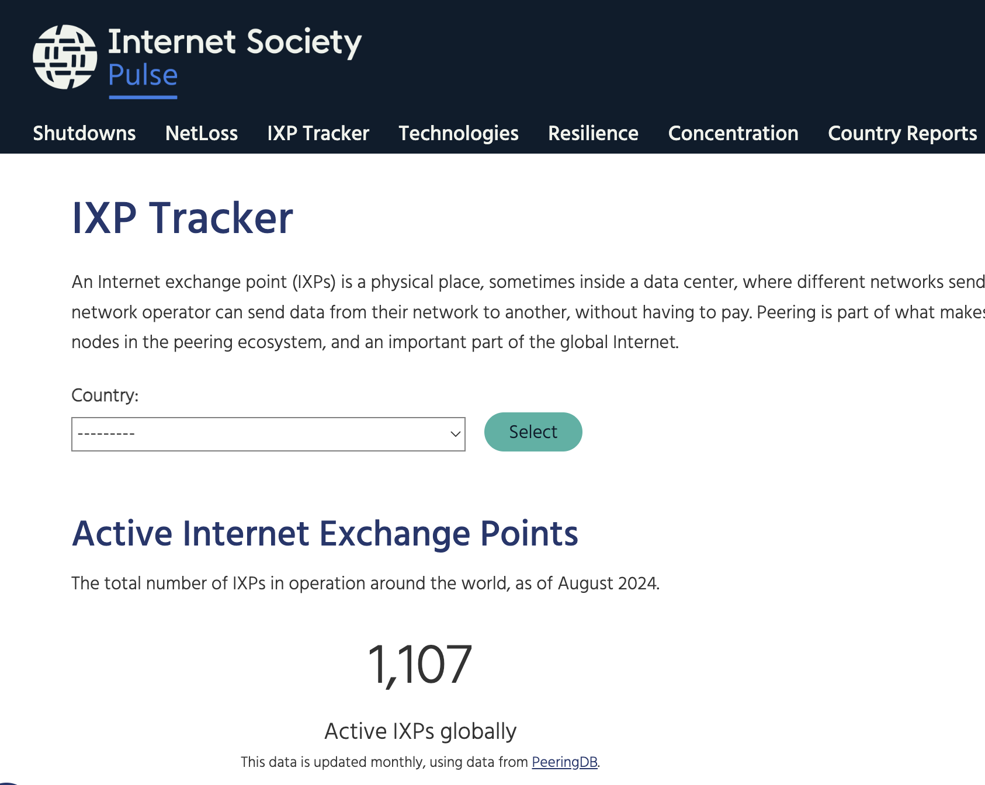
Additional features
AS level: shows details about IXPs where a given AS is connected, including prefixes, address space and customer cone.
Prefix level: displays information about all the IXPs a given prefix is reachable, including AS Path length metrics.
Compare two IXPs: reachability (prefixes and networks reachable), customer cone, AS Path length.
Network benefits calculator: We can ask an AS to upload its routing table into the IXP Tracker and select an IXP to see the networking benefits.

Slide 31
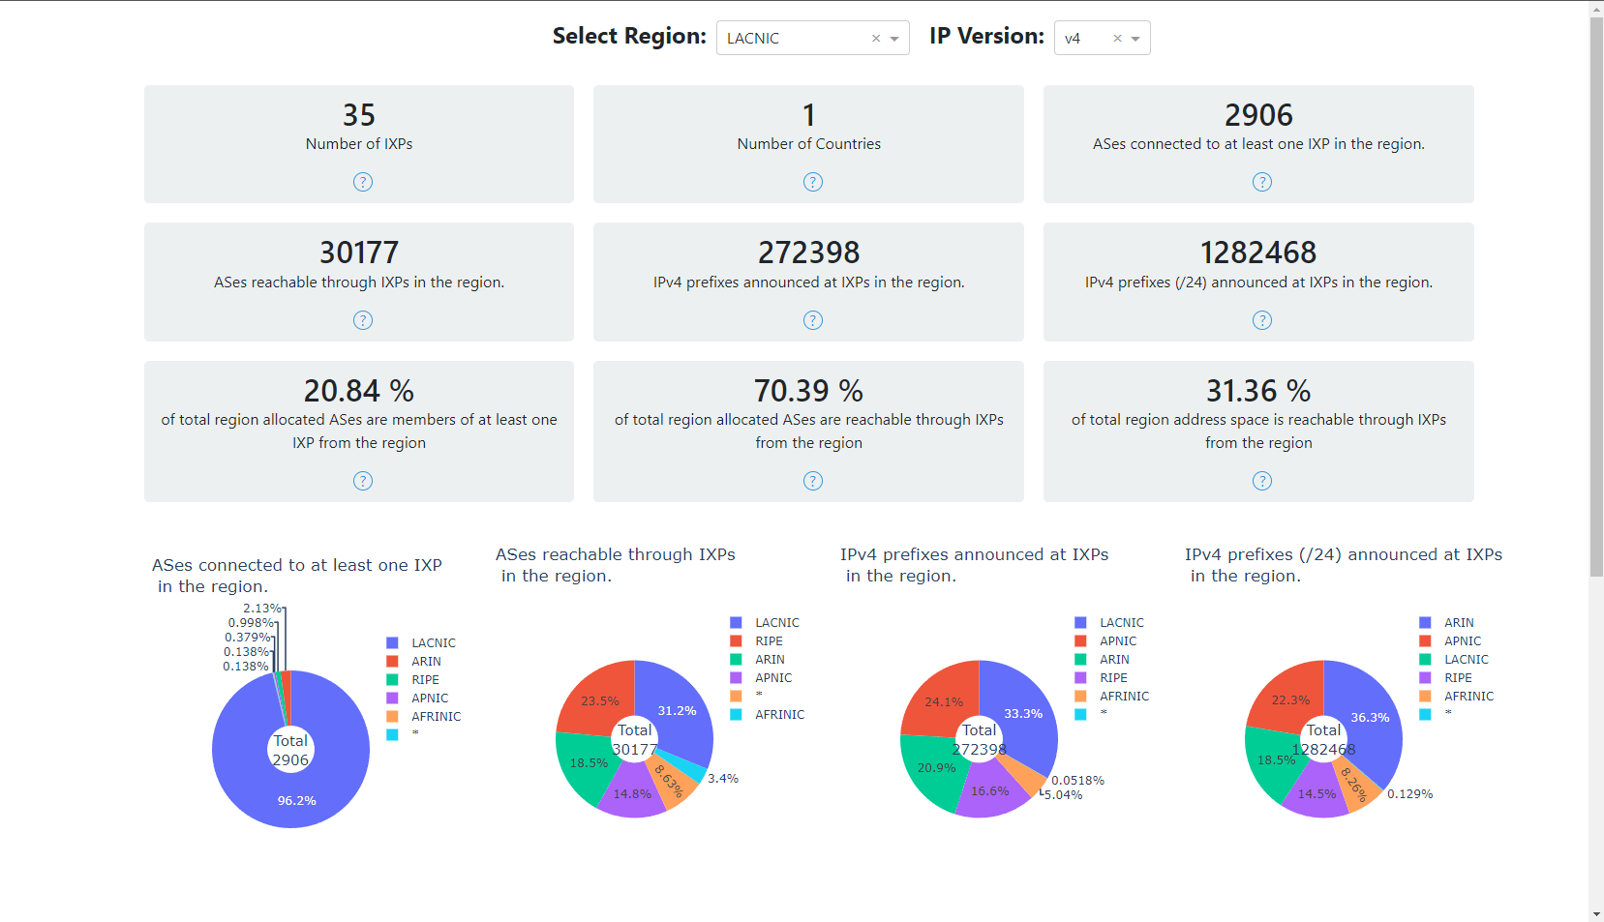
Region view - Statistics
Notes:
Cost
Reachable ASes
AS Path lengths
Routing stability
Traffic detours

Slide 32
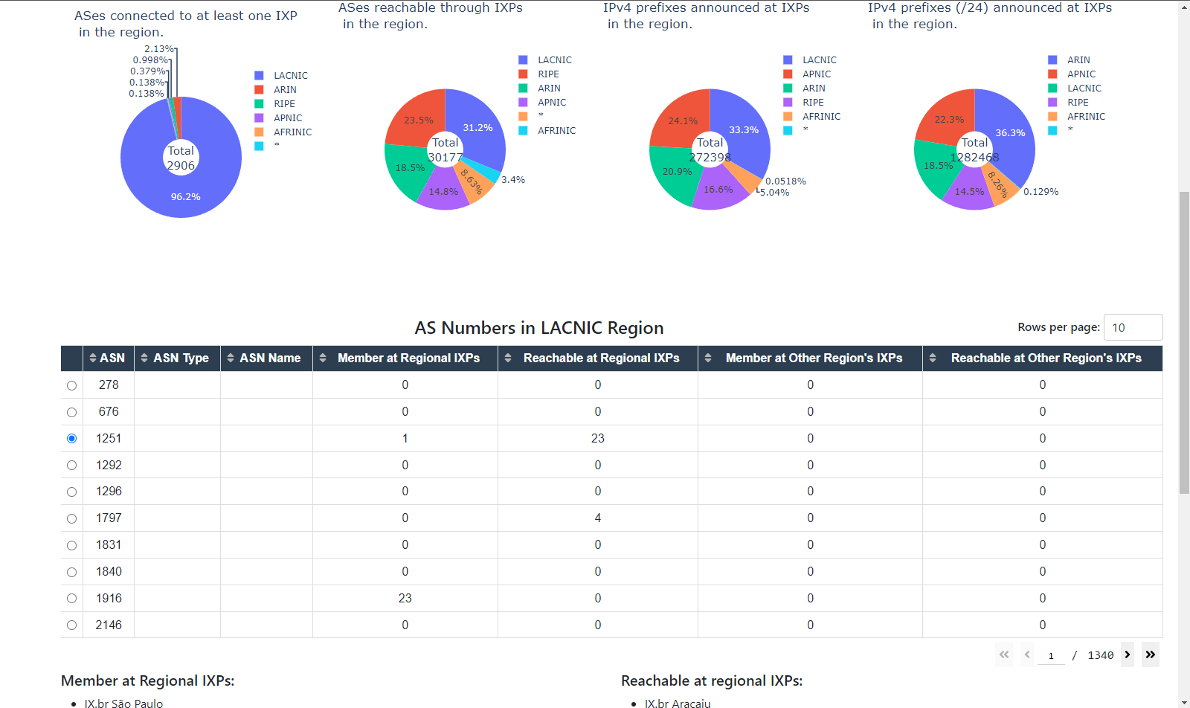
Region view - Table (ASes)

Slide 33
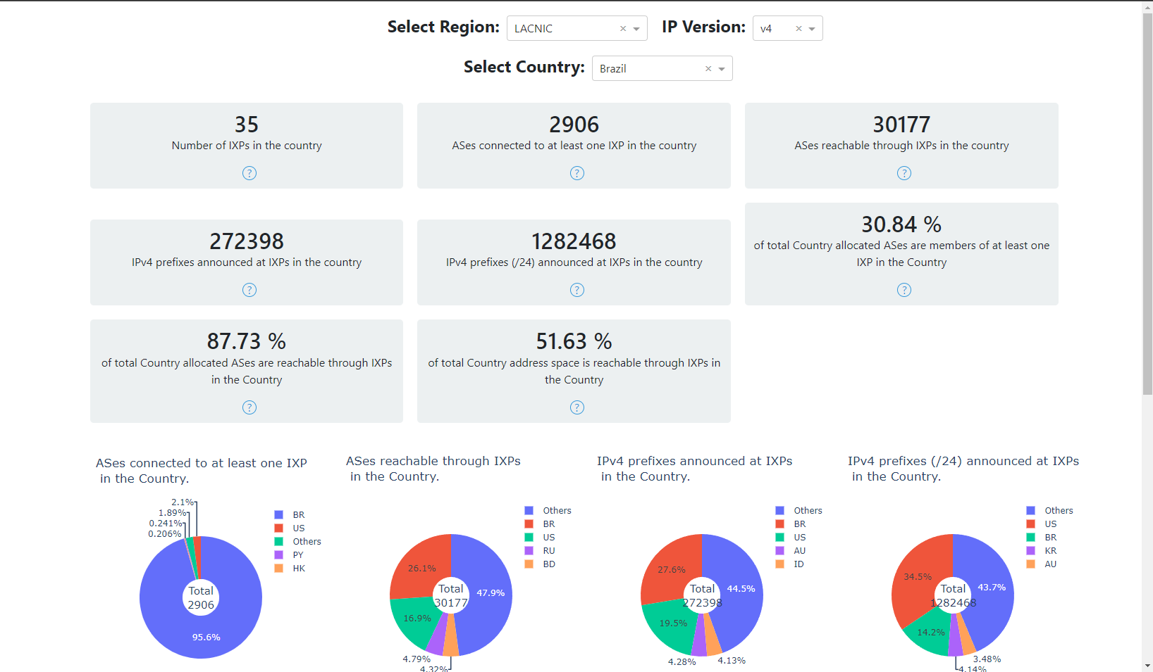
Same analysis for Country view…

Slide 34
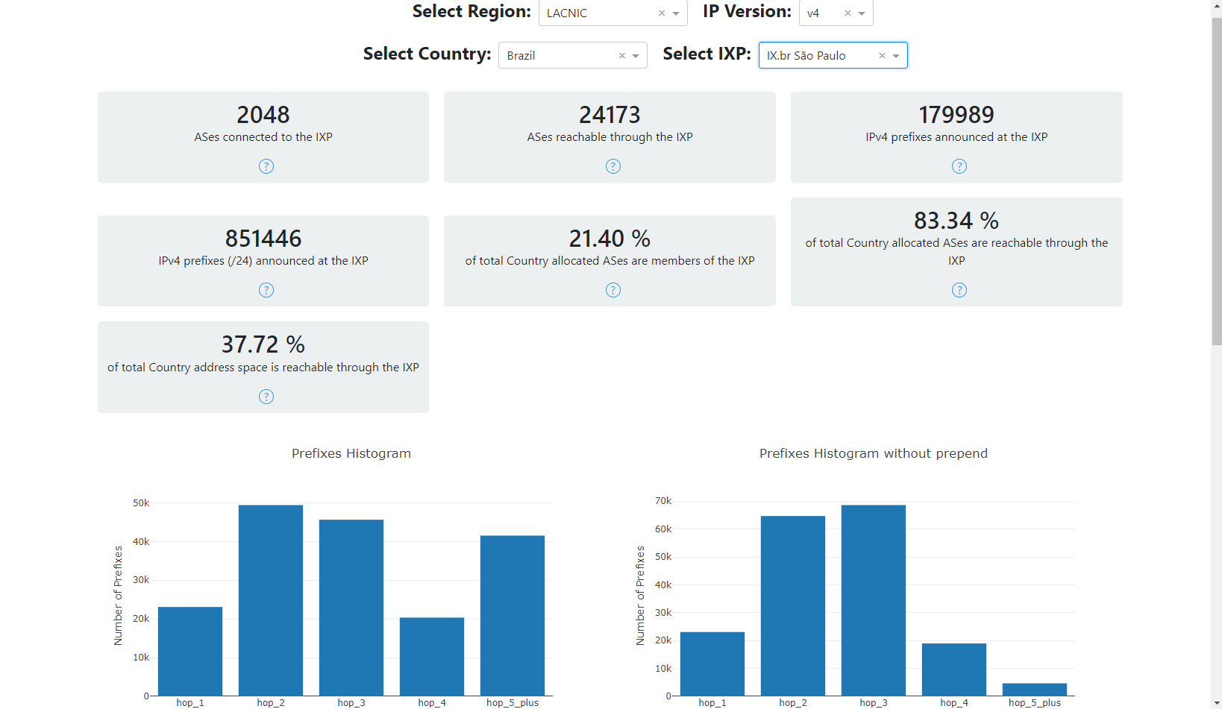
IXP view - Statistics

Slide 35
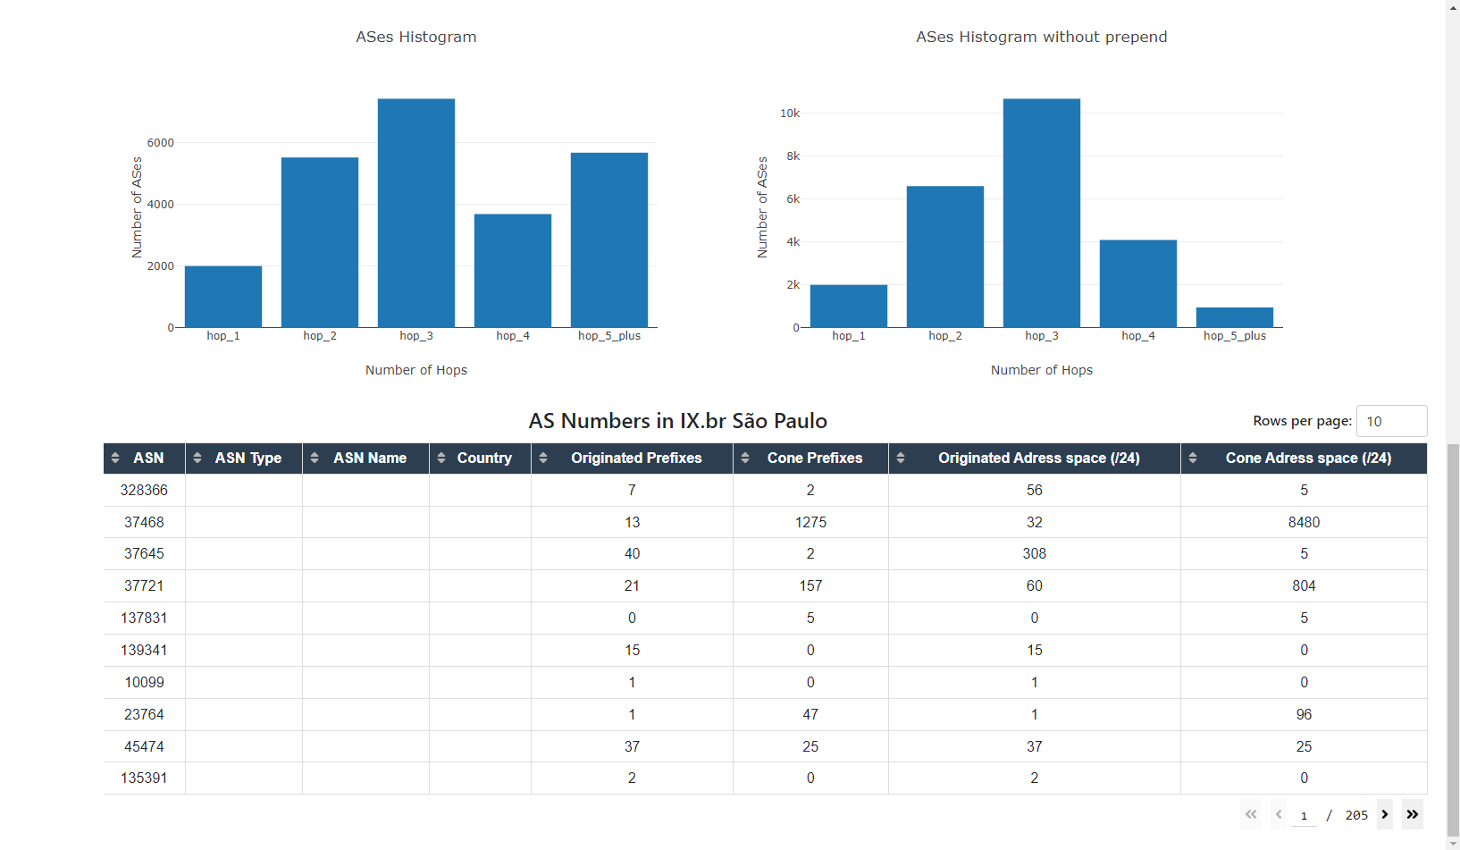
IXP view - Table

Slide 36
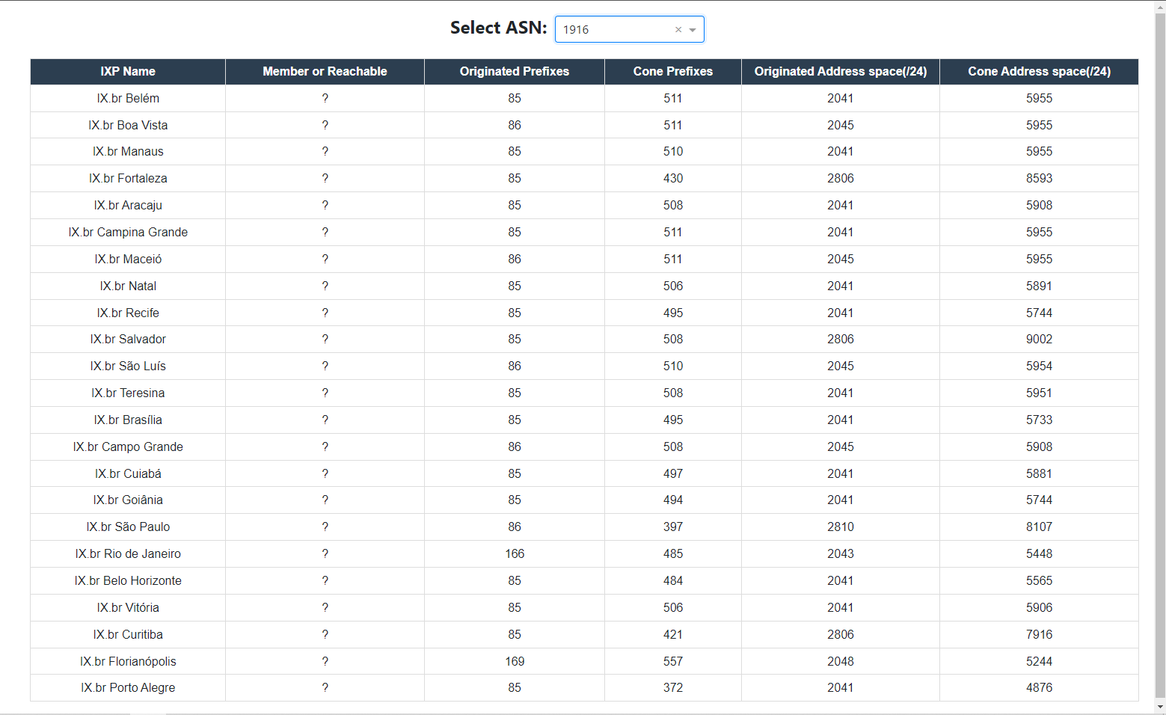
AS view

Slide 37
Achieving Our Goals Together

Slide 38
Grant Program
We fund local communities to:
Build IXPs in markets where they are needed
Level-up existing IXPs to realize their full potential
Develop regional organizations and communities that support peering and interconnection.
Grants assist in training, capacity building, community development, and equipment purchases.
https://www.internetsociety.org/ funding-areas/sustainable-peering-ixp/

Slide 39
Our Grant Partners
The Internet Society’s work is partially funded by generous grants from Meta, ICANN, and AMS-IX.
Our peering and interconnection work endeavors to:
Further our 50/50 Vision
Strengthen our collaboration with regional partners on IXP development

Slide 40
Subscribe, Review, Contribute
Subscribe to the Pulse newsletter
Review the Pulse IRI methodology
Contribute to Pulse
pulse@isoc.org
Notes:
Finally, if you’re interested in keeping abreast of our project, please subscribe to our monthly newsletter.
Or email us to discuss opportunities to partner or contribute to our Blog.
I’ve also shared a link to the methodology of the IRI for those interested in the sources and calculations.

Slide 41
Hanna Kreitem

