Slide 1
RPKI ROV Adoption in the Middle East
Doug Madory

Slide 2
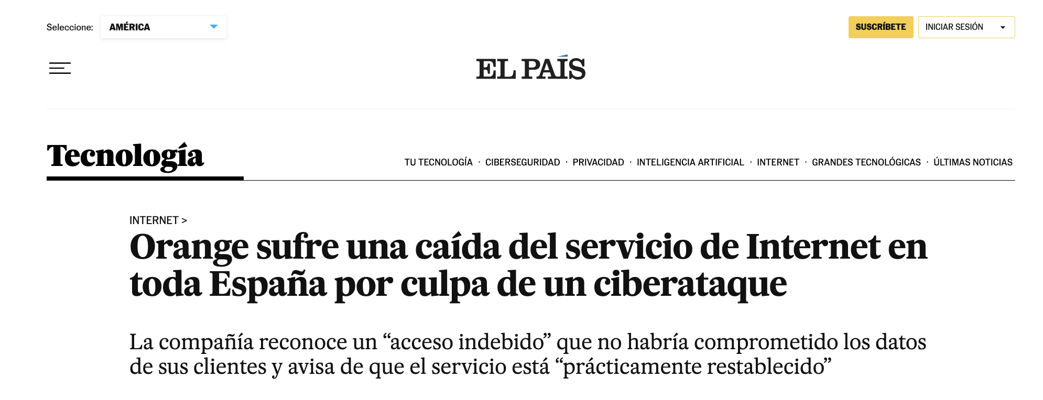
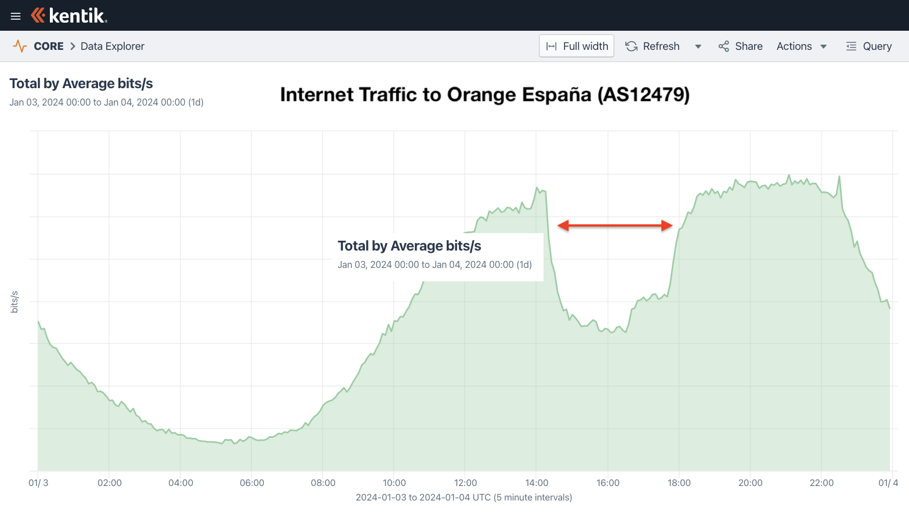
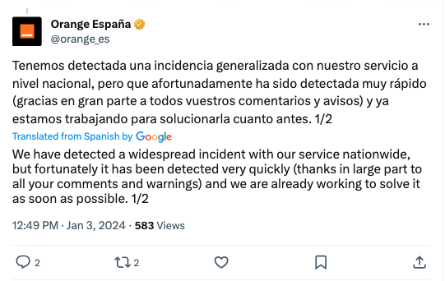
Orange España outage (Jan 3, 2024)
Orange suffers a drop in Internet service throughout Spain due to a cyber attack
The company recognizes “improper access” that would not have compromised its customers' data and warns that the service is “practically restored”

Slide 3
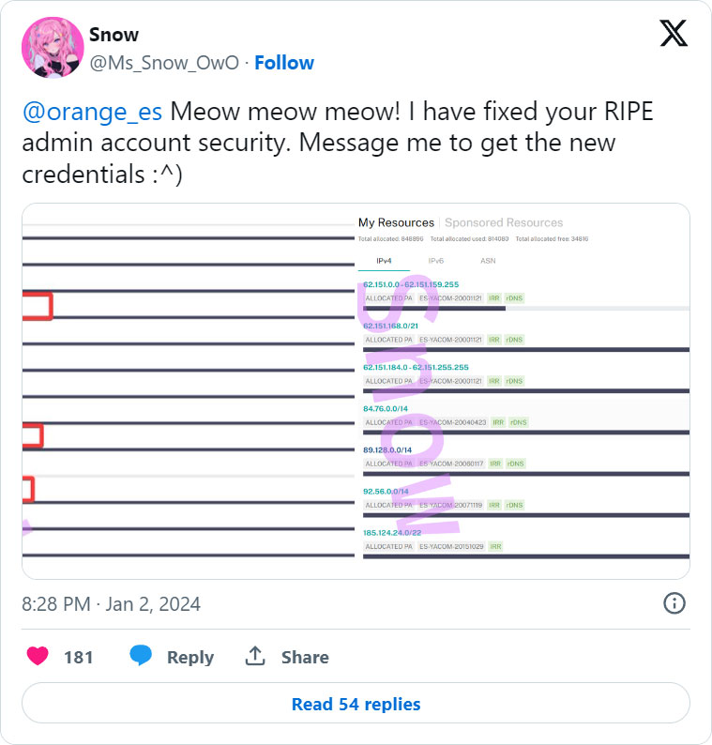

Why did Orange España suffer an outage?
Hacker was able to log into company’s RIPE NCC portal using the password “ripeadmin” found in a public leak of stolen credentials. Oops!
Hacker altered Orange España's RPKI configuration, rendering many of its BGP routes RPKI-invalid.
No traffic was misdirected, no data was compromised.
Outage marked the first time RPKI ROV was used as a vector for a denial-of-service.
But to really understand the significance of the outage, we must understand RPKI and the state of BGP security
https://www.kentik.com/blog/digging-into-the-orange-espana-hack/

Slide 4
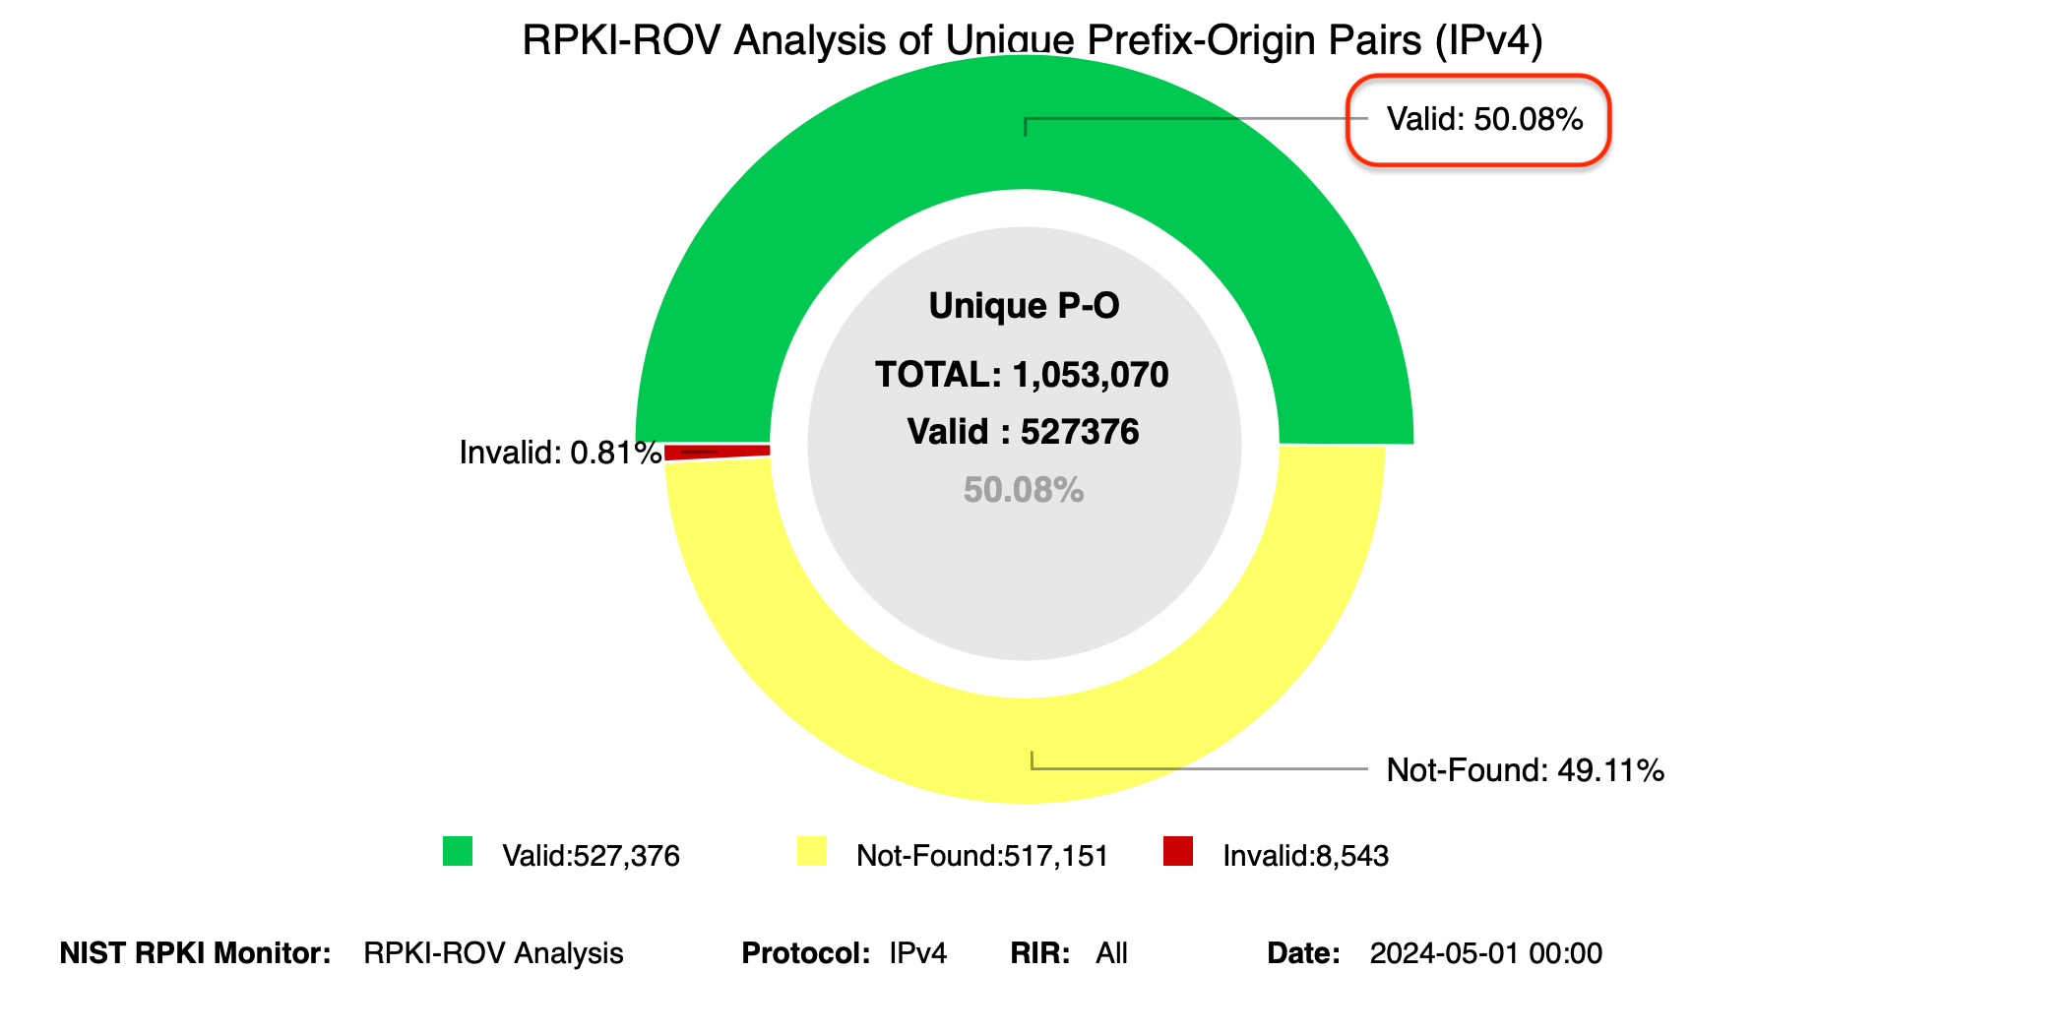
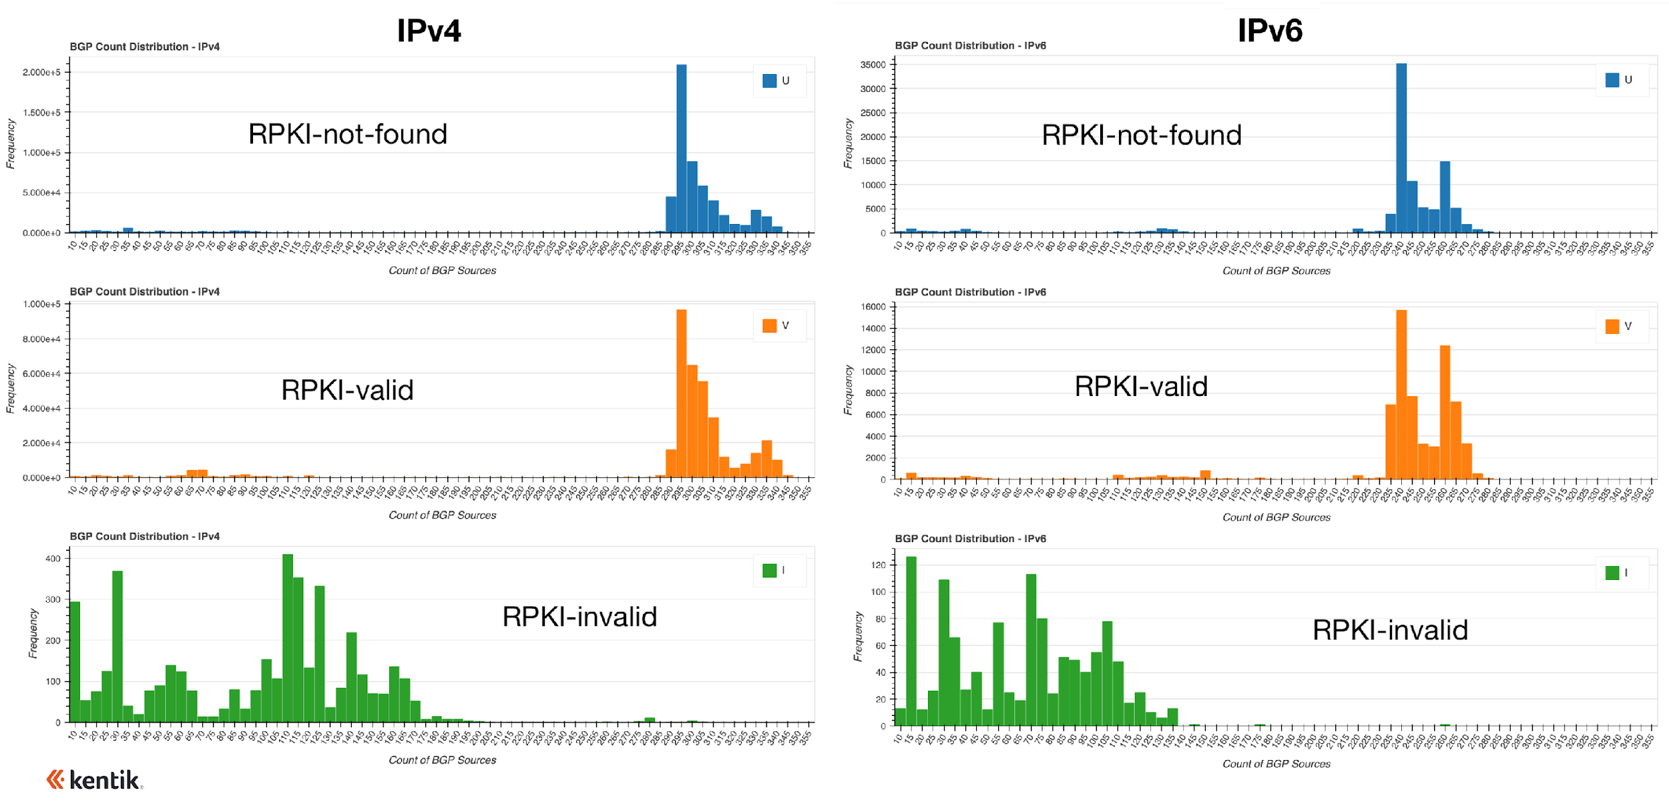
Let’s understand the current state of RPKI ROV adoption

Slide 5
Measuring RPKI deployment progress
Two steps needed to identify and reject RPKI-Invalid BGP routes.
1
2
  Create ROAs to define correct origins for address space
  ASes reject RPKI-invalid routes that don’t match ROAs

Slide 6
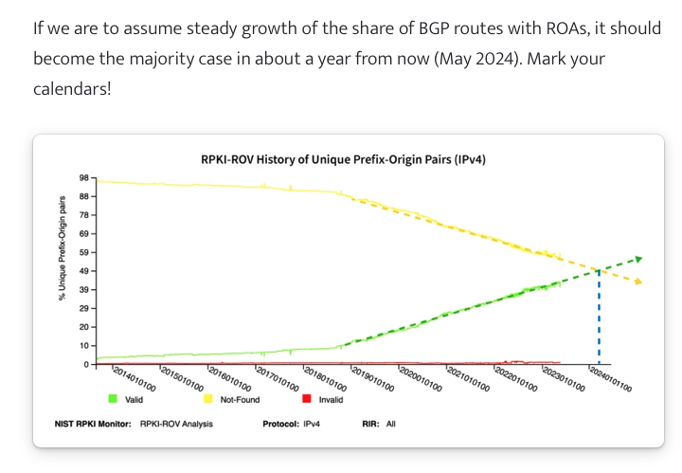
ROA Creation Predictions
Last year, we made this bold prediction in our post:
https://www.kentik.com/blog/exploring-the-latest-rpki-rov-adoption-numbers/

Slide 7
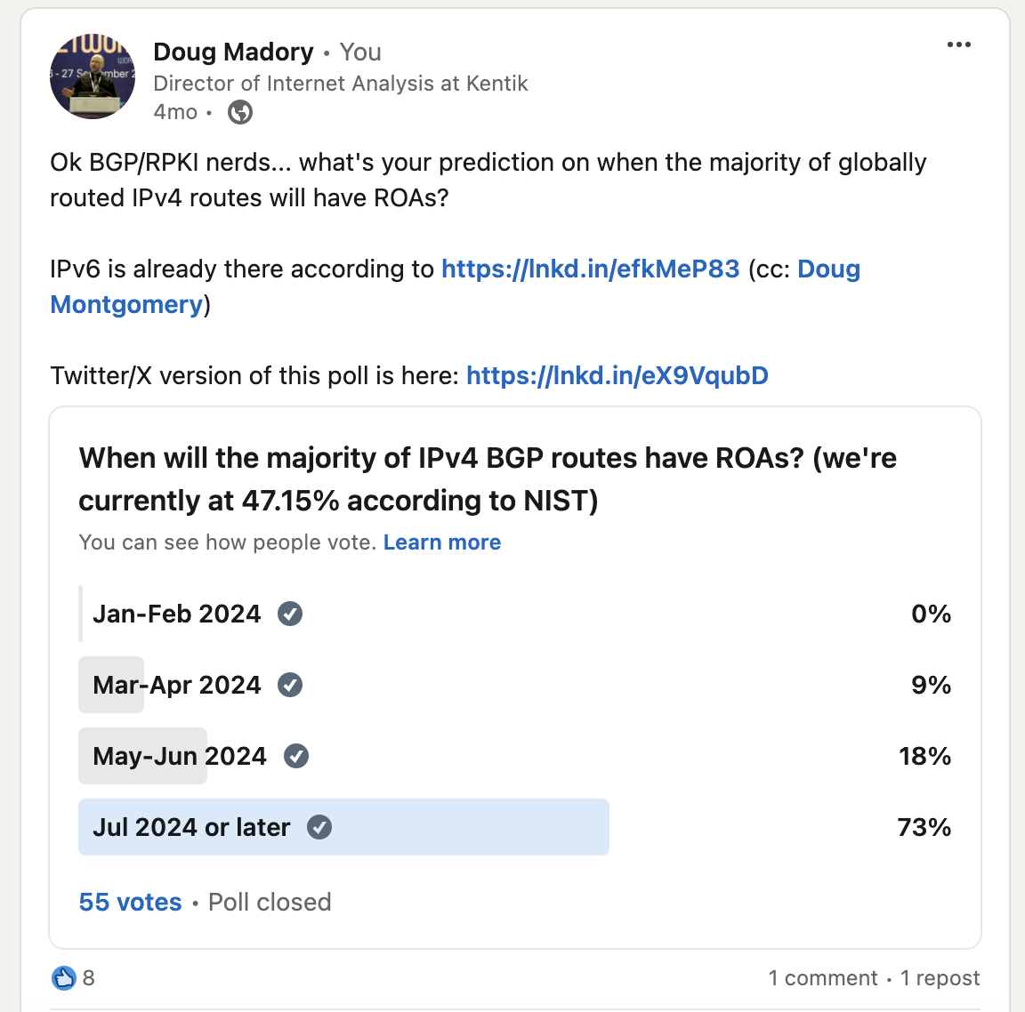
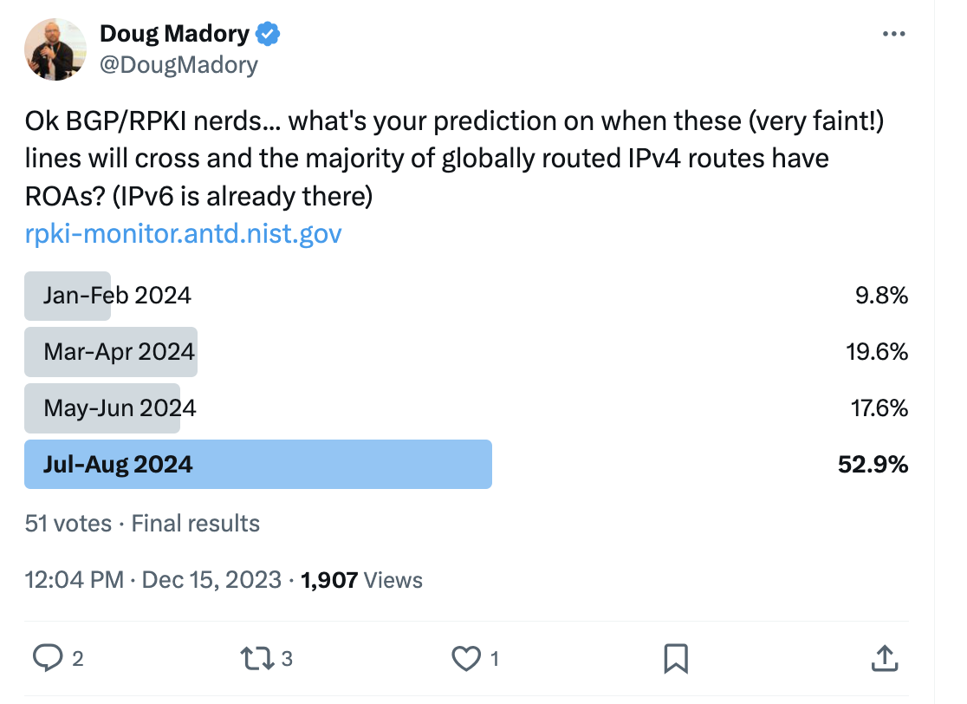
ROA Creation Predictions
But y’all were doubters!

Slide 8
Measuring RPKI deployment progress
We recently passed a milestone (May 1):
  >50% of IPv4 routes in global routing table have ROAs (NIST RPKI monitor)
IPv6 achieved this late last year

Slide 9
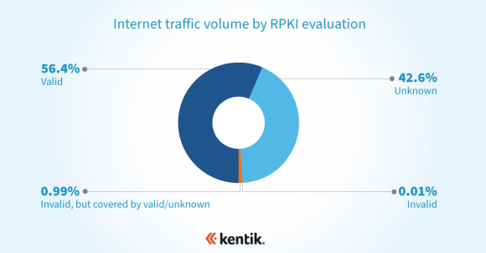
Measuring RPKI deployment progress
But RPKI ROV is ultimately about protecting traffic, so …
At NANOG 84 in Austin, TX, we explored ROA creation (1.) using Kentik’s aggregate NetFlow
  1/3 of BGP routes had ROAs, just >1/2 of traffic (bps) went to routes with ROAs
Stats from Feb 2022:
How has this changed since?

Slide 10
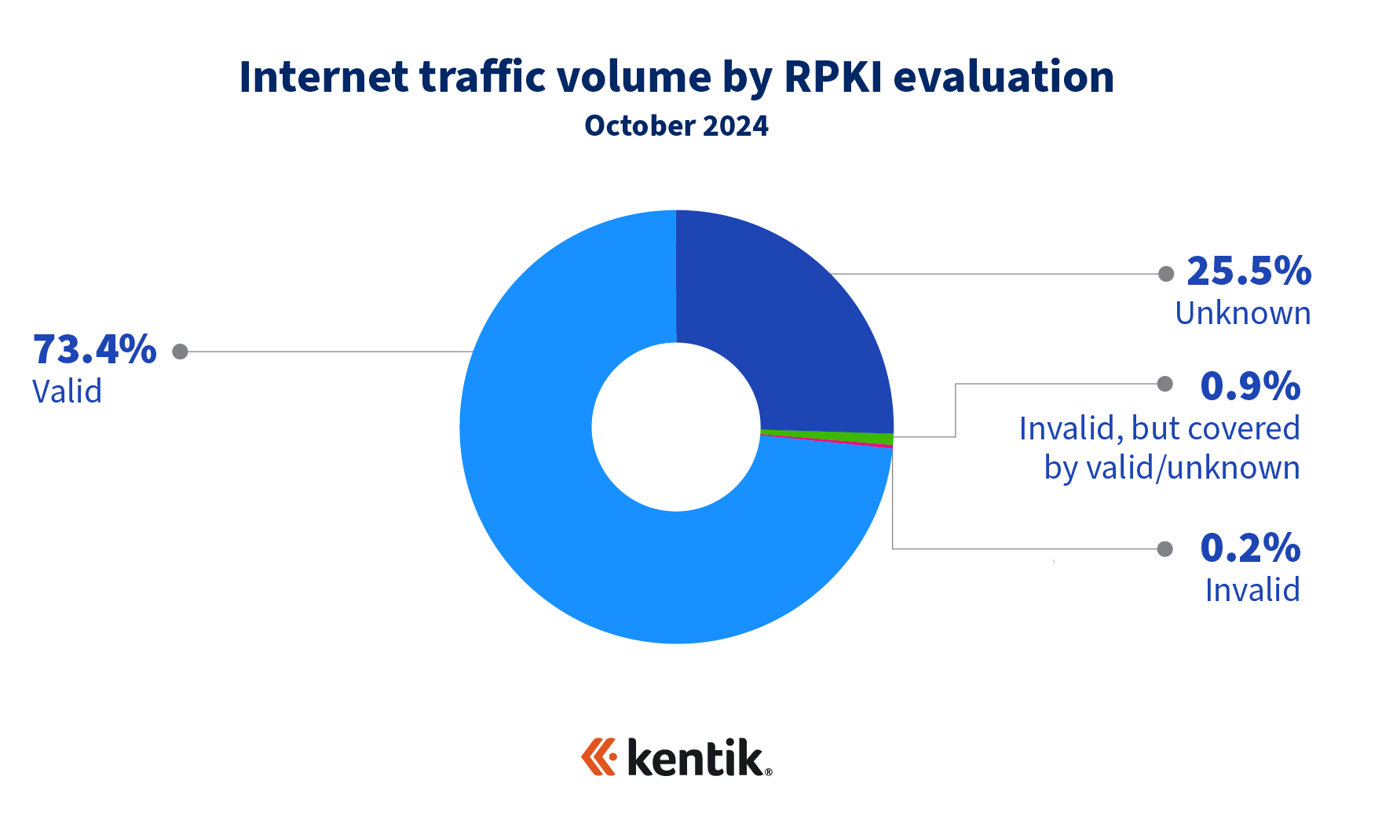
Measuring RPKI deployment progress
But RPKI ROV is ultimately about protecting traffic, so …
At NANOG 84 in Austin, TX, I explored ROA creation (1.) using Kentik’s aggregate NetFlow
  Feb 2022: 1/3 of BGP routes had ROAs, >1/2 of traffic (bps) went to routes with ROAs
  Oct 2024: >1/2 of BGP routes have ROAs, <3/4 of traffic (bps) went to routes with ROAs

Slide 11
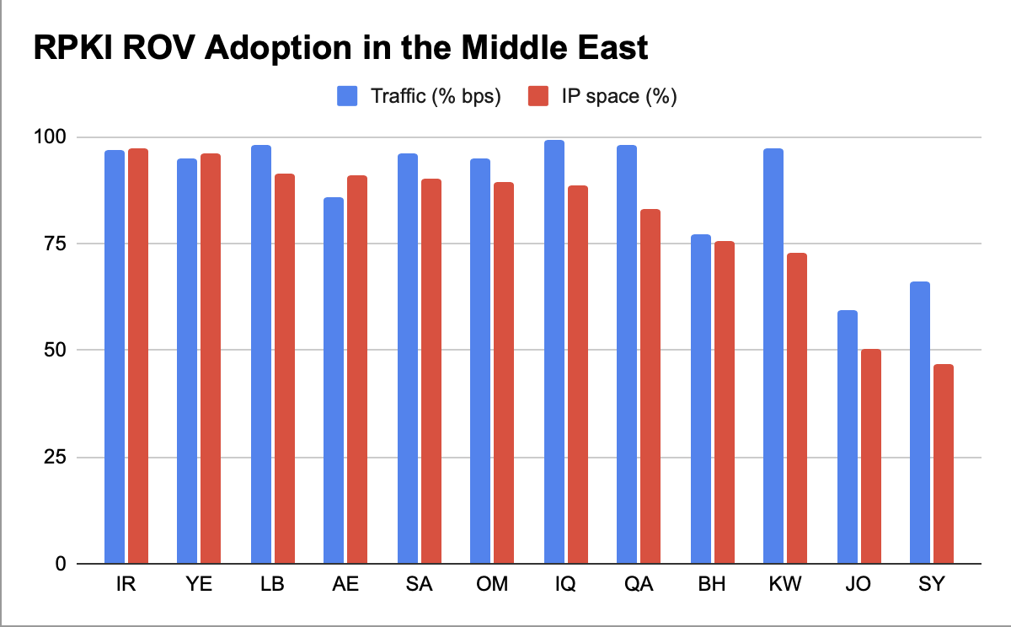
Measuring RPKI deployment in the Middle East
Very high levels of ROA creation in ME
93.5%(!) of traffic to ME goes to routes with ROAs

Slide 12
Propagation Reduction of RPKI-Invalids
ROAs alone are useless if only a few networks are rejecting invalid routes.
2022 analysis showed propagation of RPKI-invalid routes is half or less than other types.
Stats from Aug 2022
How has this changed since?
https://www.kentik.com/blog/how-much-does-rpki-rov-reduce-the-propagation-of-invalid-routes/

Slide 13
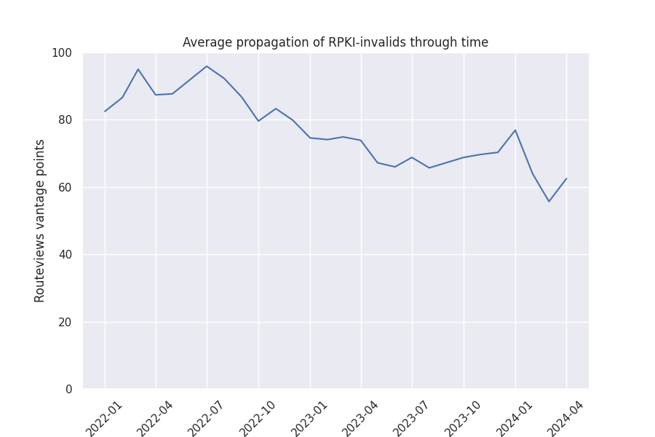
RPKI-Invalid Propagation Declining
24% decline in the propagation of RPKI-invalids
Analyzing propagation of RPKI-invalid routes over time faces challenges:
  Set of persistently RPKI-invalid routes not guaranteed to stay constant.
  Propagation is heavily influenced by which providers are transiting a route.
Does the trend hold for RPKI-invalid beacons?

Slide 14
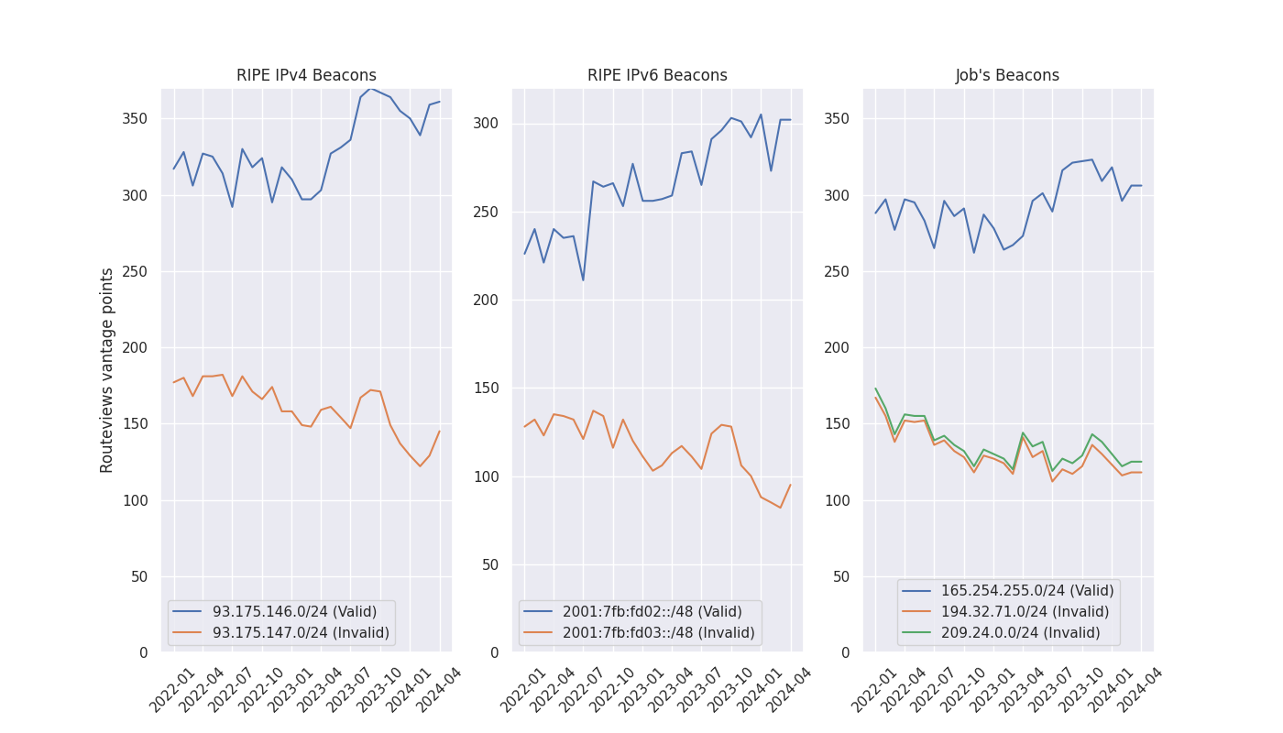
RPKI-Invalid Propagation Declining
RIPE NCC and Job Snijders (AS15562) announce RPKI-invalid (and RPKI valid) routes for measurement of RPKI ROV deployment.
Invalid routes from each of these beacons all experienced an overall decline in propagation while the control routes saw increased propagation.
RPKI-valids
RPKI-invalids

Slide 15
Invalid Propagation Different for ARIN and RIPE
Final observation:
  Two RPKI-invalid routes in “Job’s Beacons” experience slightly different propagation.
ROAs published in different RIR TALs:
  209.24.0.0/24 (green) is in the ARIN TAL
  194.32.71.0/24 (orange) is in the RIPE TAL
Accepting the ARIN TAL requires a lengthy Relying Party Agreement that some providers refuse to accept.
Result:
  ROAs published by ARIN are seen by fewer networks.
  Slightly reducing the efficacy of RPKI ROV for ARIN managed IP space.

Slide 16
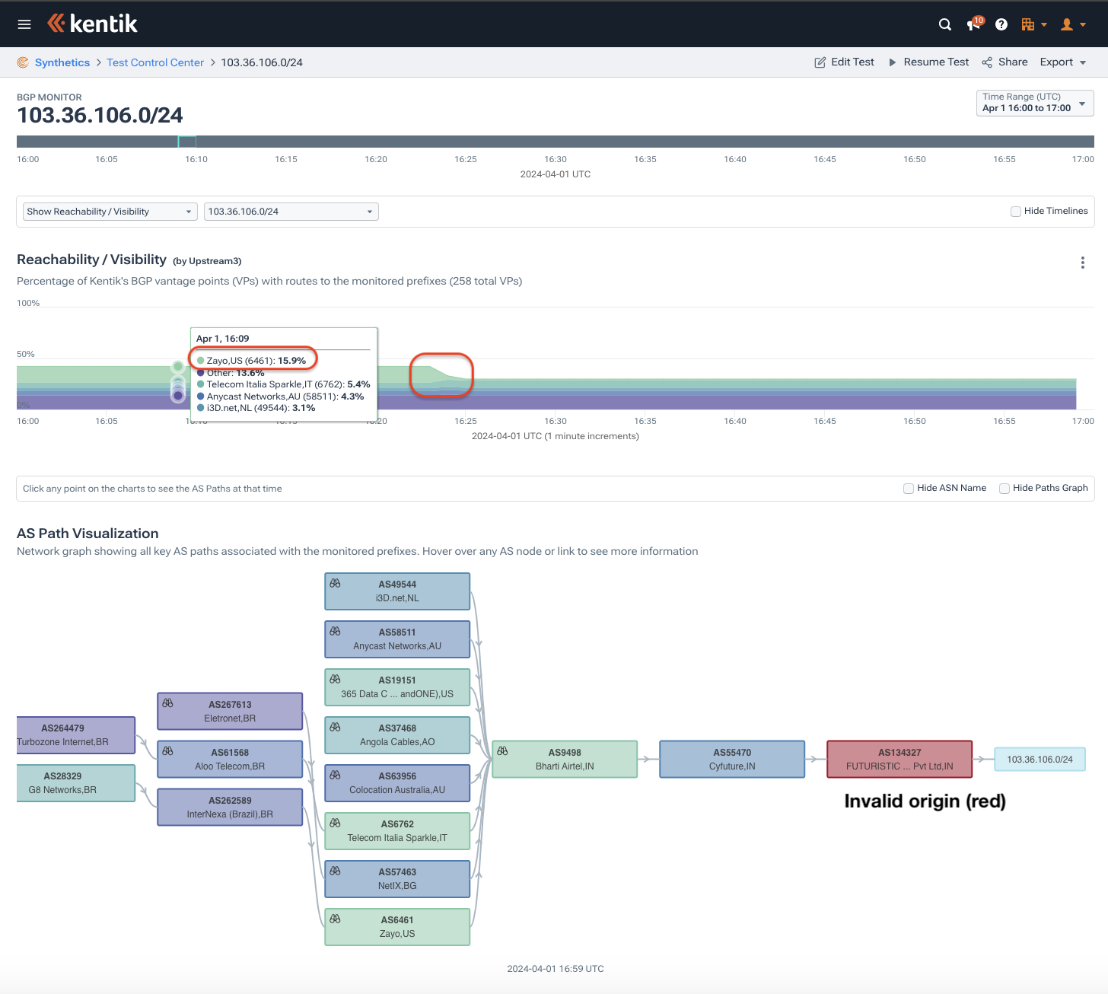
Another Tier-1 AS Rejecting RPKI-Invalids
Much of the reduction of propagation of RPKI-invalid routes is due to the rejection of invalids by Tier-1 (DFZ) ASes.
Another RPKI milestone in April:
  An additional Tier-1 AS began rejecting RPKI-invalid routes from customer networks.
  On April 1 at 16:24 UTC, we saw Zayo (AS6461) begin rejecting RPKI-invalid routes.

Slide 17
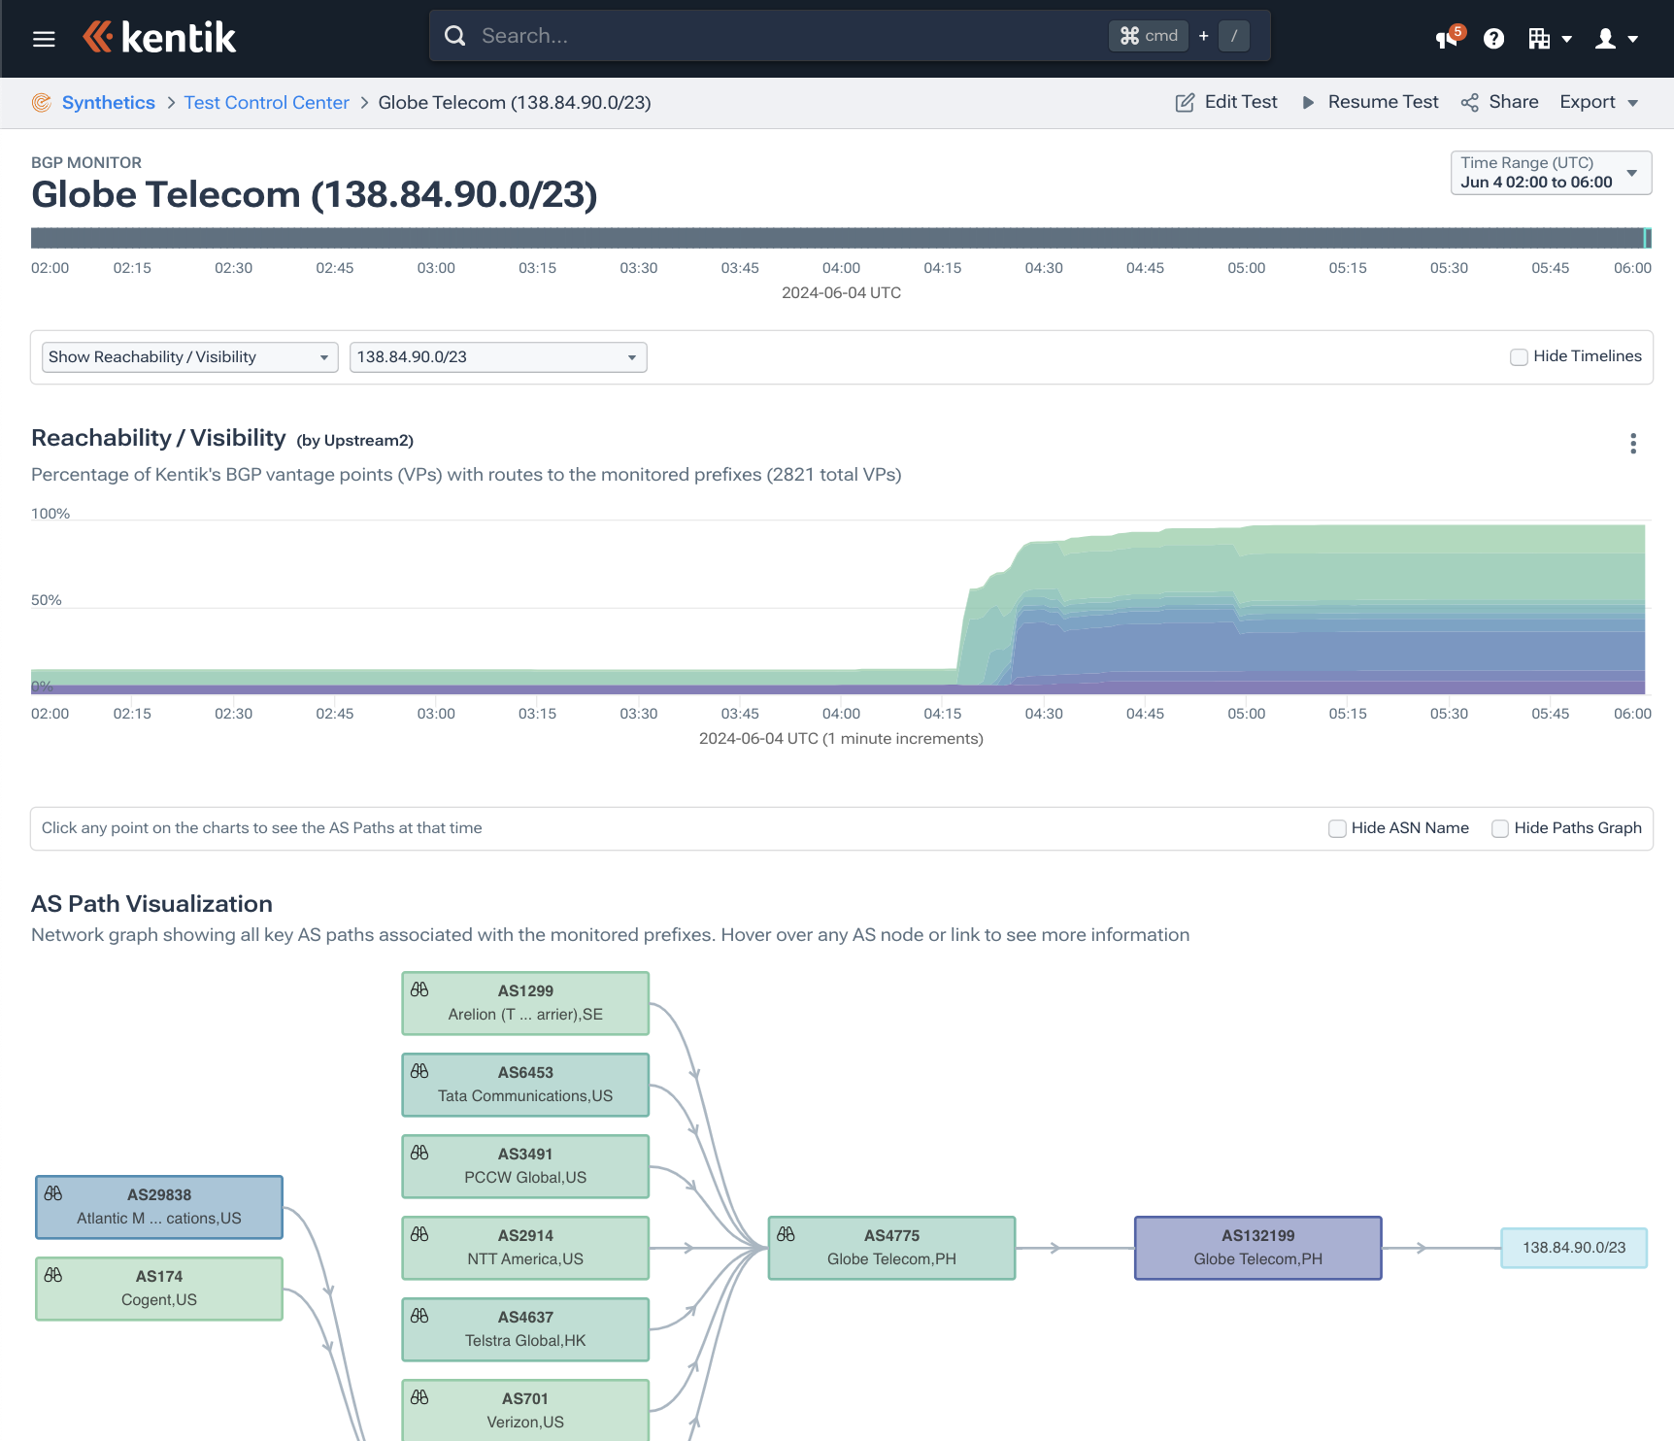
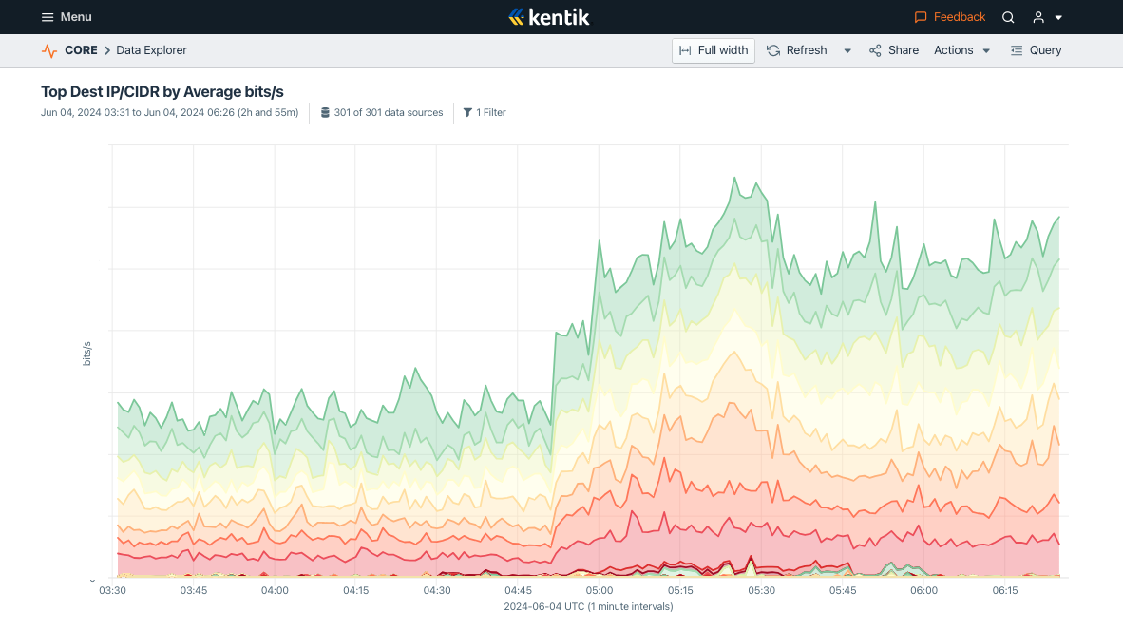
Fixing ROA misconfigurations
Globe Telecom (PH) recently fixed several ROAs causing routes to be RPKI-invalid.
Traffic volume to previously RPKI-invalid routes increased.

Slide 18
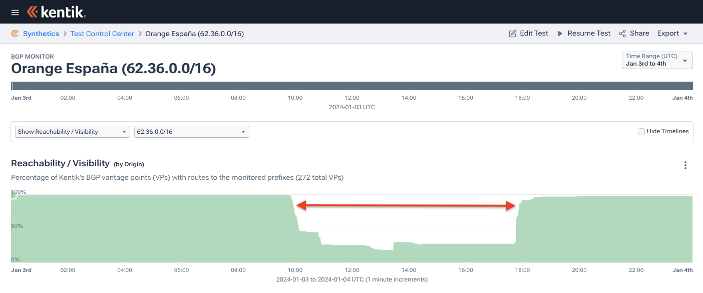
Coming back to the Orange España hack
Hacker gained access to Orange España’s RIPE NCC account and altered RPKI configuration, rendering many of its BGP routes RPKI-invalid.
The wielding of RPKI as a tool for denial of service was only possible due to the pervasive extent to which ASes reject RPKI-invalid routes.
https://www.kentik.com/blog/digging-into-the-orange-espana-hack/

Slide 19
A Call To Action
Reject RPKI-invalids.
  Given that the majority of BGP routes have ROAs (including a super majority of traffic), networks should reject RPKI-invalid routes to avoid mistakenly egressing traffic based on the acceptance of mis-originated routes.
Create ROAs.
  And given the scale to which RPKI-invalid routes are suppressed, it would benefit resource holders to create ROAs for their address ranges to enable networks around the world to automatically reject mis-originated routes.

Slide 20
Conclusion
Progress due to the dedicated efforts of hundreds of engineers at dozens of companies.
  1/2 of BGP routes have ROAs, >2/3 of traffic (bps) went to routes with ROAs
  Propagation of RPKI-invalids continues to decline, Zayo now rejecting invalids
RPKI ROV doesn’t solve all the issues surrounding Internet routing security.
  Only an opening salvo towards addressing the various “determined adversary” scenarios best characterized by the recent attacks against cryptocurrency services.
Need to build off the progress made by RPKI ROV to address more difficult scenarios.

Slide 21

Thank you!
Doug Madory
dmadory@kentik.com
@DougMadory
in/DougMadory

