Slide 1
RPKI Deployment Levels
in Romania
The Role of ROAs and ROV
Riccardo Stagni | RIPE NCC | IMD Romania | 1 October 2024

Slide 2
Routing Security
Notes:
This is the original blabla from Qasim:
In our interconnected digital world, routing security is the bedrock of a stable, reliable, and trustworthy internet. It ensures that data packets traverse the vast network landscape safely and efficiently, reaching their intended destinations without interference or misdirection.
When we talk about routing security, we have to start with BGP, or Border Gateway Protocol. BGP is one of the core protocols responsible for deciding how data moves across different networks. It's essentially the GPS of the internet, guiding packets of information through the complex maze of interconnected networks that make up the global internet infrastructure.
However, there's a significant problem at the heart of this crucial system: BGP wasn't designed with security in mind.

Slide 3
The Need for RPKI
Border Gateway Protocol (BGP4)
Extremely trustful, “routing by rumour”
Attackers or misconfigurations can redirect traffic and cause outages or data theft
Can we get rid of it? Can we update it? Can we add something out of band?
Why RPKI?
Resource Public Key Infrastructure
Initially introduced to make informed routing decisions (by verifying the legitimacy of BGP announcements with digitally signed statements)
But can do more!
Helps mitigate both accidental and malicious BGP incidents

Slide 4
Enhancing Routing Security with RPKI
RPKI has two parts:
Signing and Validating
The most known usage is to validate the origin of BGP announcements
i.e. “Is this ASN authorised to originate this particular prefix?”
Route Origin Authorisation (ROA): objects stating which ASNs are authorised to announce specific IP prefixes (signed by the prefix holder)
Route Origin Validation (ROV): verifying the origin of BGP announcements based on ROAs and ensuring only valid routes are accepted (done by every network operator)
It’s actually a generic framework
Many more payloads: ASPA, RSC, etc.

Slide 5
The RPKI Era – Enhanced Routing Security
Telegram Block Attempt (July 2023):
Misconfigured BGP advertisement blackholed global traffic
Networks doing ROV rejected incorrect routes
Cloudflare 1.1.1.1 Incident (June 2024):
Routing misconfiguration caused service disruption
ROV helped prevent incorrect route propagation lowering the impact
More validation (and ASPA) would have made both events even less eventful
We are getting there...
Notes:
Two examples where ROAs allowed automatic rejection of hijacks lowering the global impact
https://www.kentik.com/blog/iraq-blocks-telegram-leaks-blackhole-bgp-routes/
https://blog.cloudflare.com/cloudflare-1111-incident-on-june-27-2024/

Slide 6
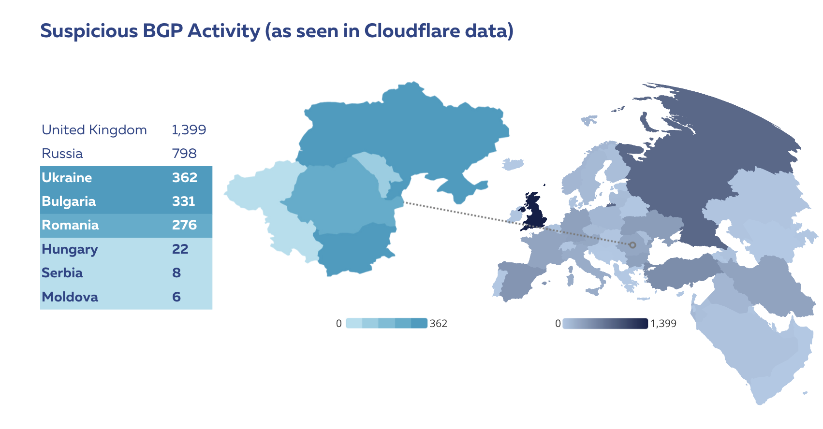
Notes:
Where is this coming from? Ask Alun.

Slide 7
Route Origin Authorisation
Notes:
Remind that we’re focusing on ROA/ROV
ASPA & co are still being developed and not yet as widespread as ROA/ROV

Slide 8
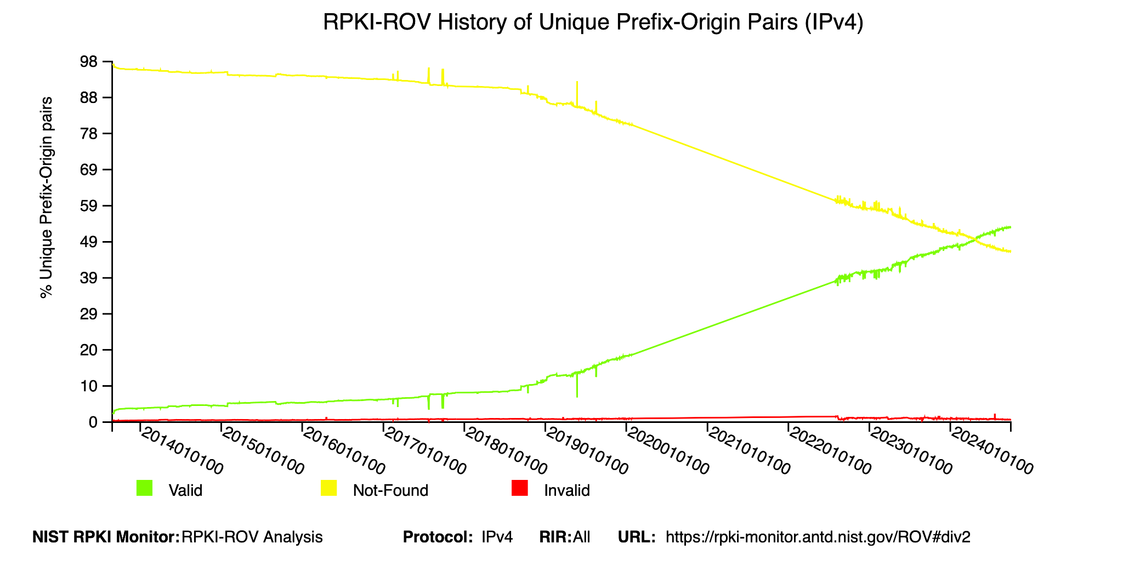

Slide 9
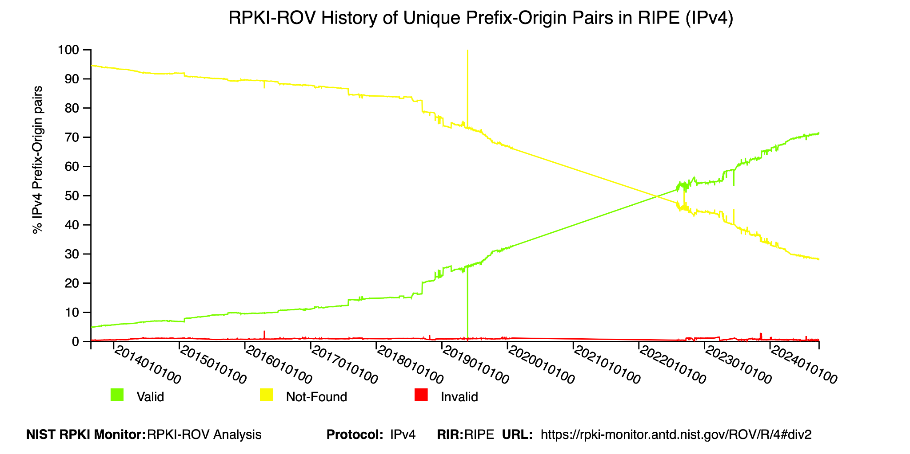

Slide 10
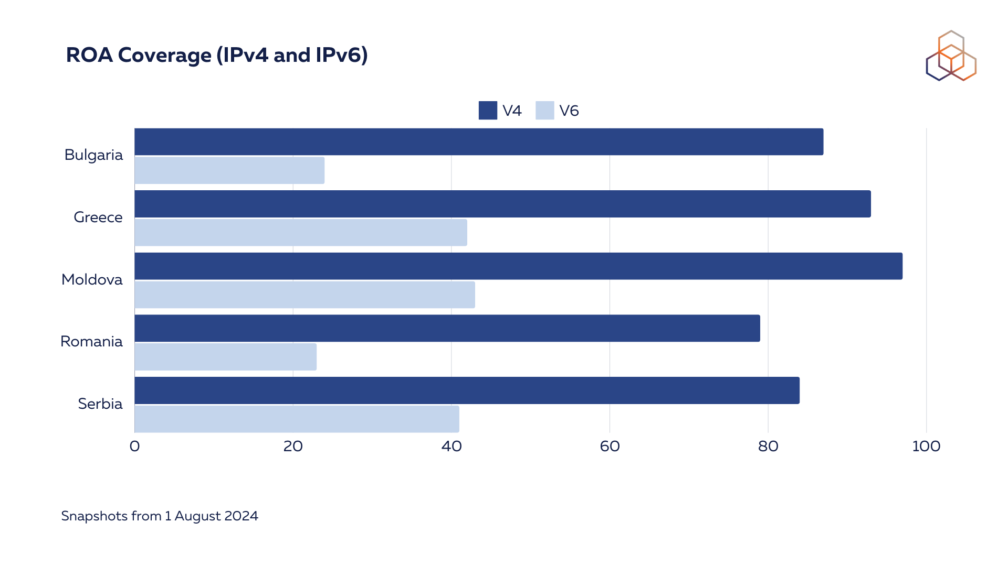

Slide 11
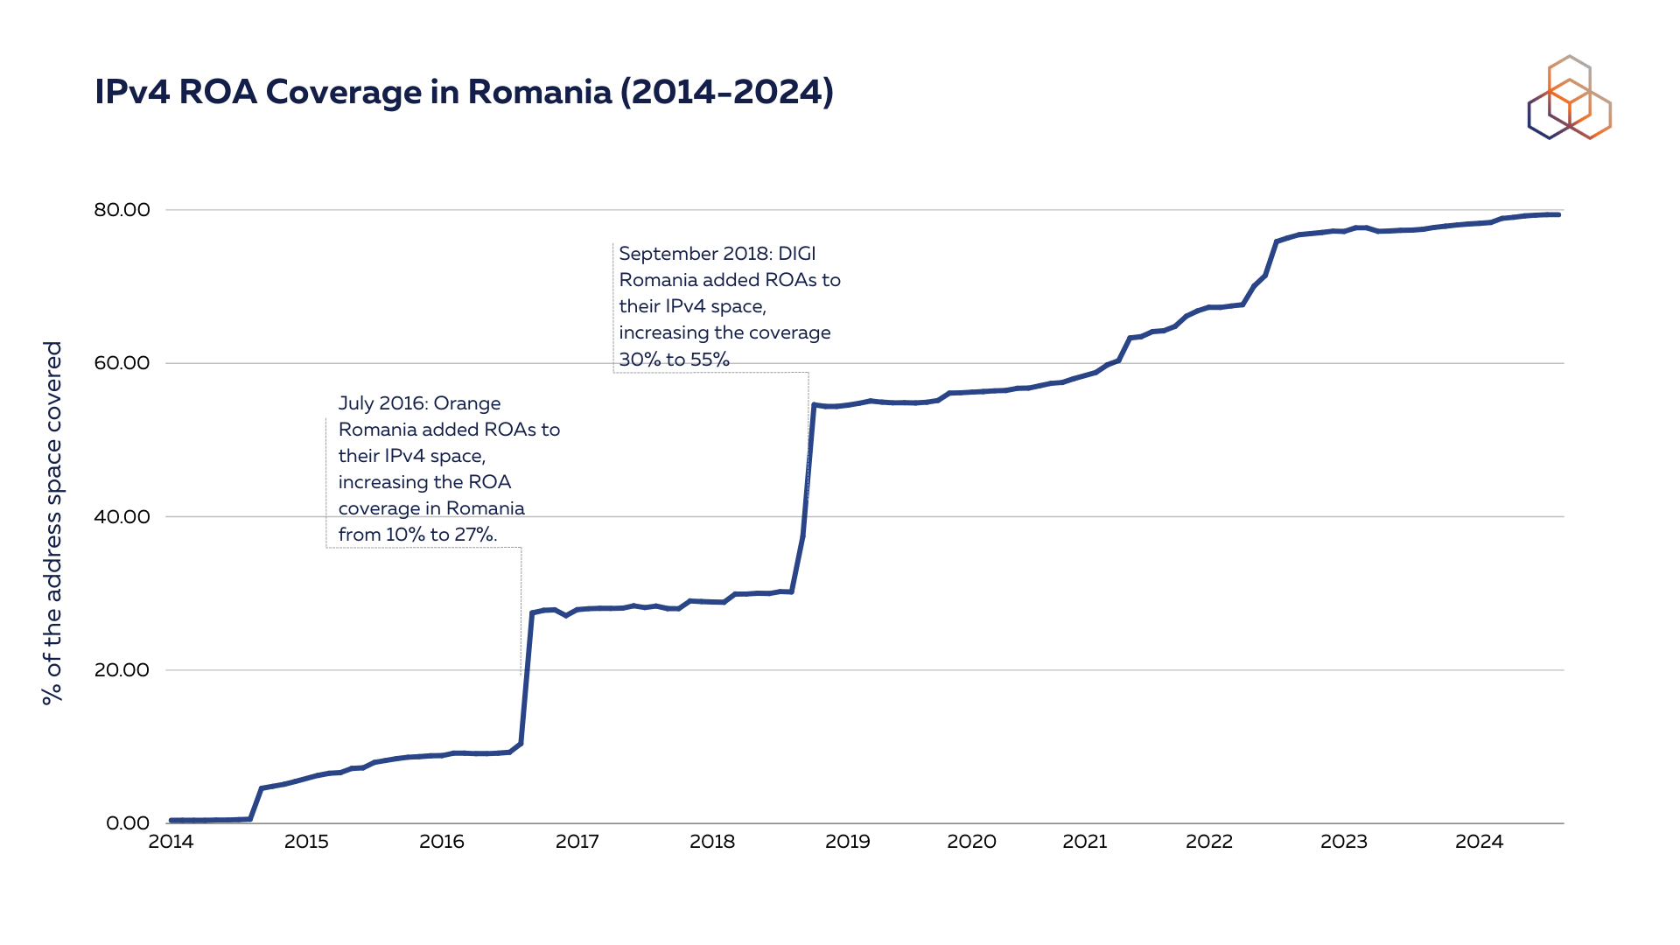

Slide 12
Route Origin Validation

Slide 13
Measuring ROV
We use RoVISTA to analyse deployment of ROV across the region:
Scores are based on the number of RPKI-invalid prefixes that an AS can reach
We used a different and more inclusive approach: we consider an AS to be doing ROV if there is any trace of ROV deployment (in the AS itself or its upstreams)
Collateral benefit (when the upstreams do ROV)
The ROV impact is assessed from the perspective of network centrality
AS Hegemony metric measures the centrality of ASes within a country
Which are the most common transit networks to a local AS?
And how much does this specific AS relies on these transit networks?
Provides the fraction of paths crossing a given node (based on BGP data)
Notes:
This is from Qasim slides:
RoVista's methodology combines two main techniques: identifying hosts under RPKI-invalid prefixes and measuring connectivity between end hosts using the IP-ID side-channel technique. It validates BGP routing entries with ROAs and identifies hosts under RPKI-invalid prefixes as potential targets. Using the IP-ID side-channel, RoVista assesses whether an Autonomous System (AS) can reach these targets, which suggests if ROV filtering is performed. By testing multiple hosts within an AS, RoVista computes a "ROV ratio" based on the fraction of unreachable targets, helping mitigate errors and improve accuracy.
We do consider an AS as having implemented ROV if their score is non-zero, i.e. as long as there is any ROV deployment.
[1] RoVista https://rovista.netsecurelab.org
[2] AS Hegemony, https://labs.ripe.net/author/romain_fontugne/as-hegemony-measuring-as-interdependence/

Slide 14
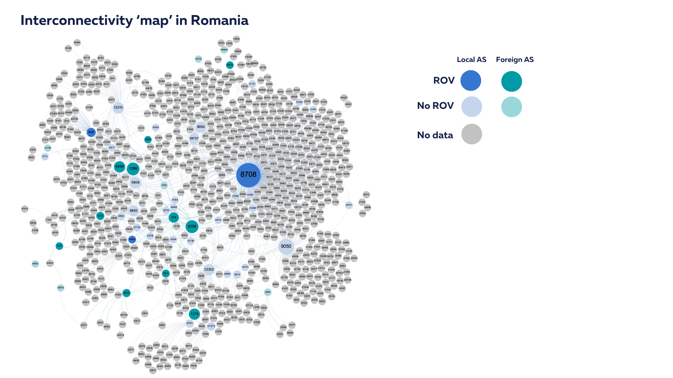
Notes:
Plot made by Qasim, here is his blabla:
While RoVista's results are promising, interpreting them requires caution. Even if many hosts within an AS consistently filter RPKI-invalid prefixes, this doesn't guarantee that the AS itself has deployed ROV—it could be benefiting from a higher-tier provider's ROV deployment, a phenomenon known as "collateral benefit." In the AS graph, it's important to focus on central ASes that haven't deployed ROV. While all ASes benefit from ROV deployment, the more "central" ASes, especially those providing major transit, will experience greater collateral benefits.
RO has 19M inhabitants

Slide 15
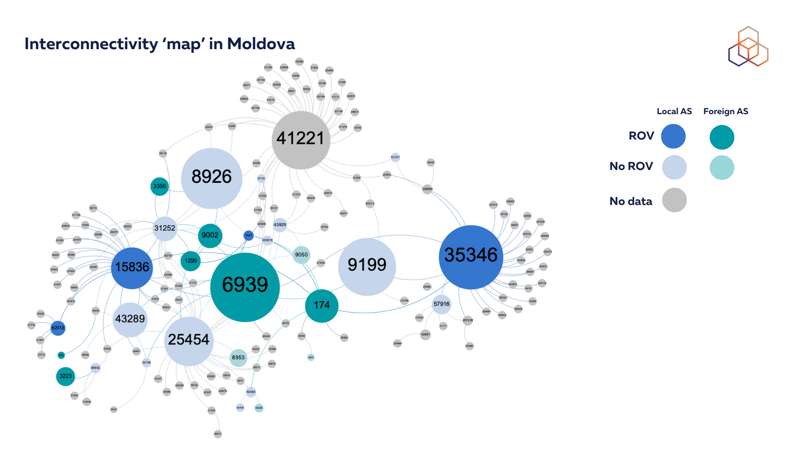

Slide 16
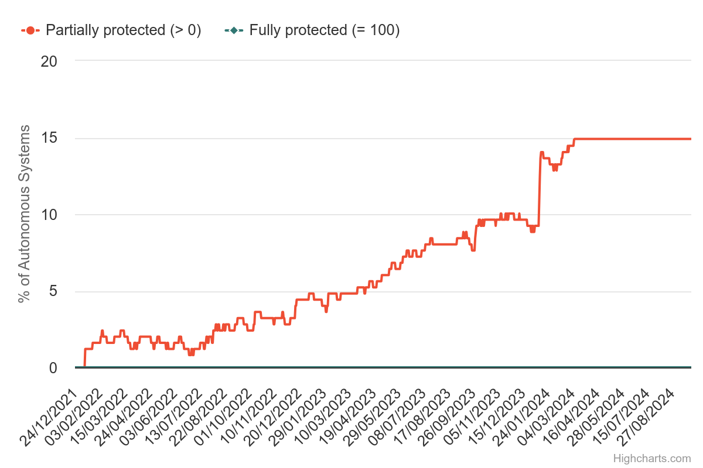
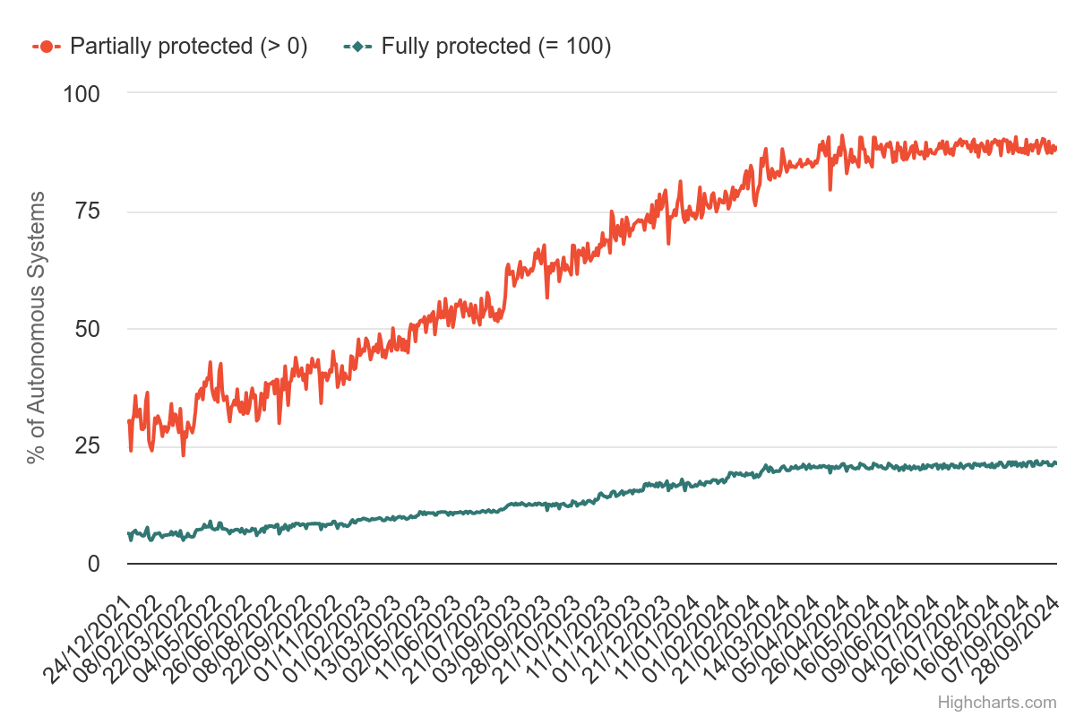
ROV Romania compared to the World
Notes:
From https://rovista.netsecurelab.org/analytics
Romania on the left
World average on the right

Slide 17
Wrapping Up

Slide 18
Conclusion
Does it work?
Yes
Notes:
Even if an operator doesn’t do ROV?
Many Tier-1s do, many IXPs do > “so, yes, it works anyways, but they should to further limit the spread of routing incidents”
(local incidents = low visibility incidents, difficult to find out)
The damage from routing incidents is confined
Sign ROAs and protect your network! (and your customers)
So RPKI is kinda a low hanging fruit from the point of view of network security... and that’s why... (next slide!)

Slide 19
Conclusion – RPKI Adoption
Growing recognition of RPKI importance at government level:
White House roadmap advocating RPKI as mature solution for BGP vulnerabilities
US government aims to have 60% of advertised IP space under ARIN RSA by end of 2024, explicitly paving the way to ROAs for federal networks
Regulatory bodies taking action:
FCC (in US), proposing annual BGP security risk management plans for ISPs
Forum Standaardisatie (in NL), “comply or explain” by the end of 2024 for all governmental entities, both ROAs and ROV
Implications for Romania:
Opportunity for operators and policymakers to enhance routing security
Potential to establish guidelines and timelines for RPKI adoption
Notes:
https://www.whitehouse.gov/oncd/briefing-room/2024/09/03/press-release-white-house-office-of-the-national-cyber-director-releases-roadmap-to-enhance-internet-routing-security/
https://www.internetsociety.org/blog/2024/09/white-house-roadmap-tackles-routing-vulnerabilities/
https://docs.fcc.gov/public/attachments/DOC-403034A1.pdf
https://www.forumstandaardisatie.nl/nieuws/secured-internet-routing-dutch-government-end-2024

Slide 20
Conclusion – IPv6 Adoption
Use of IPv6 in Romania:
https://stats.labs.apnic.net/ipv6/RO
Need for policy initiatives and infrastructure investments:
Increased awareness and education is crucial
Learning Resources
RIPE NCC courses :)
IPv6 Fundamentals Training Course
https://learning.ripe.net/w/courses/3-ipv6-fundamentals-training-course
(for RIPE NCC members only, here, in a couple of days!)

Slide 21
?
Questions & Comments
rstagni@ripe.net
rpki@ripe.net

