Slide 1
Identifier
Technology
Health
Indicators (ITHI)
https://ithi.research.icann.org
Mikhail Anisimov
IMD Romania
October 1 2024

Slide 2
ITHI: an ICANN Initiative
ITHI, or Identifier Technologies Health Indicators is an ICANN initiative to “measure” the “health” of the “identifier system” that “ICANN helps coordinate”.
The goal is to produce a set of indicators that will be measured and tracked over time that will help determine if the system of identifiers is overall doing better or worse.
This is a long term project, expected to run for a number of years.

Slide 3
ITHI Data: ICANN + Partners + Contracts
This is where we need your help!
ICANN (Internal Data)
  Compliance department (M1)
  DAAR (M2)
  IMRS data (M3)
  Root zone (M7)
White box measurements with partners
  Measurements at recursive & authoritative servers
  M4, M6, M8
Black box measurements
  APNIC/Google Ads platform
  Eyeball view of resolvers M5

Slide 4
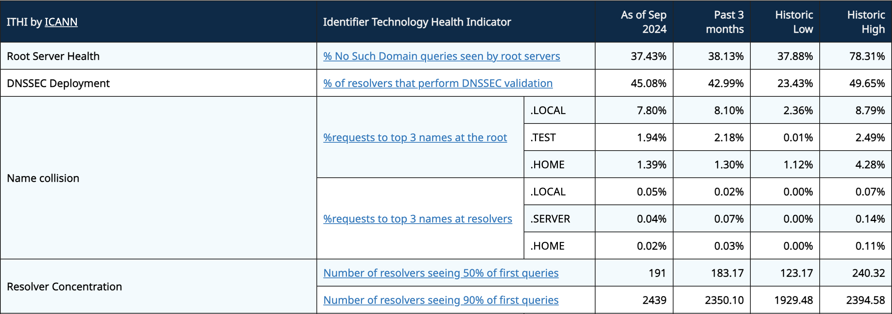
Some ITHI Results

Slide 5
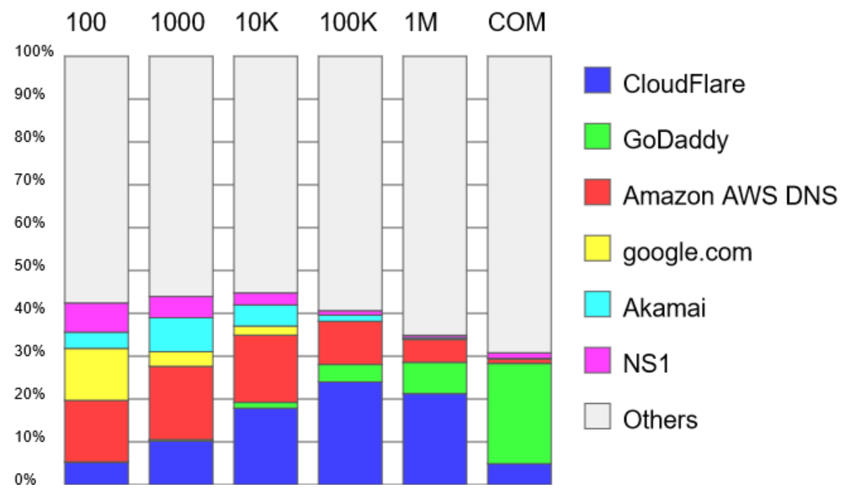
Concentration of authoritative resolvers
GoDaddy serves largest share of the COM Zone
  And some of the top 1M as well
Cloudflare and AWS serve largest shares of “middle size” domains
Cumulative share of big DNS Hosters never exceeds 50%

Slide 6
Privacy
ICANN Partner
Raw Data
ICANN Org
ITHI
Tool
Publication
Via
Open Data
Program
ITHI
Analysis
Statistics
No PII, only statistics,
are sent to ICANN org
No “naming and shaming”

Slide 7
Benefits for Partners
Comparing current results to baseline can serve as an anomaly detection system.
Partners can decide to share their data with others in exchange for reciprocity.
    if a collection point observes a divergence from its baseline but others point don't, it might be an indicator that an attack is under way.

Slide 8






Engage with ICANN
Thank You and Questions
Visit us at https://ithi.research.icann.org
Email: Alain.Durand@icann.org
@icann
linkedin/company/icann
facebook.com/icannorg
slideshare/icannpresentations
youtube.com/icannnews
soundcloud/icann
flickr.com/icann
instagram.com/icannorg

